Slide 1



Assignment 3
View in Power BI
Last data refresh:
8/12/2021 3:23:58 AM UTC
Downloaded at:
9/17/2021 2:36:17 PM UTC

Slide 2
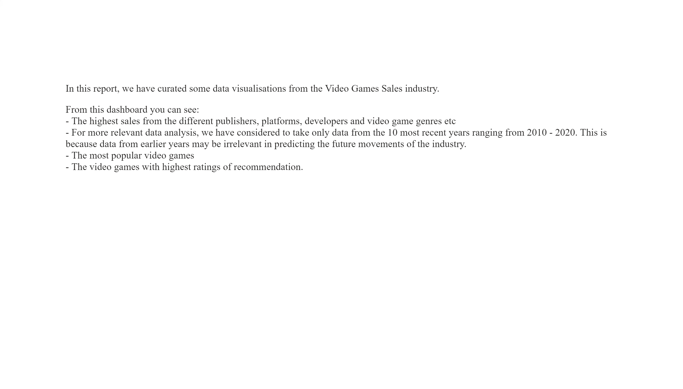
Intro
Notes:
textbox
No alt text provided.

Slide 3
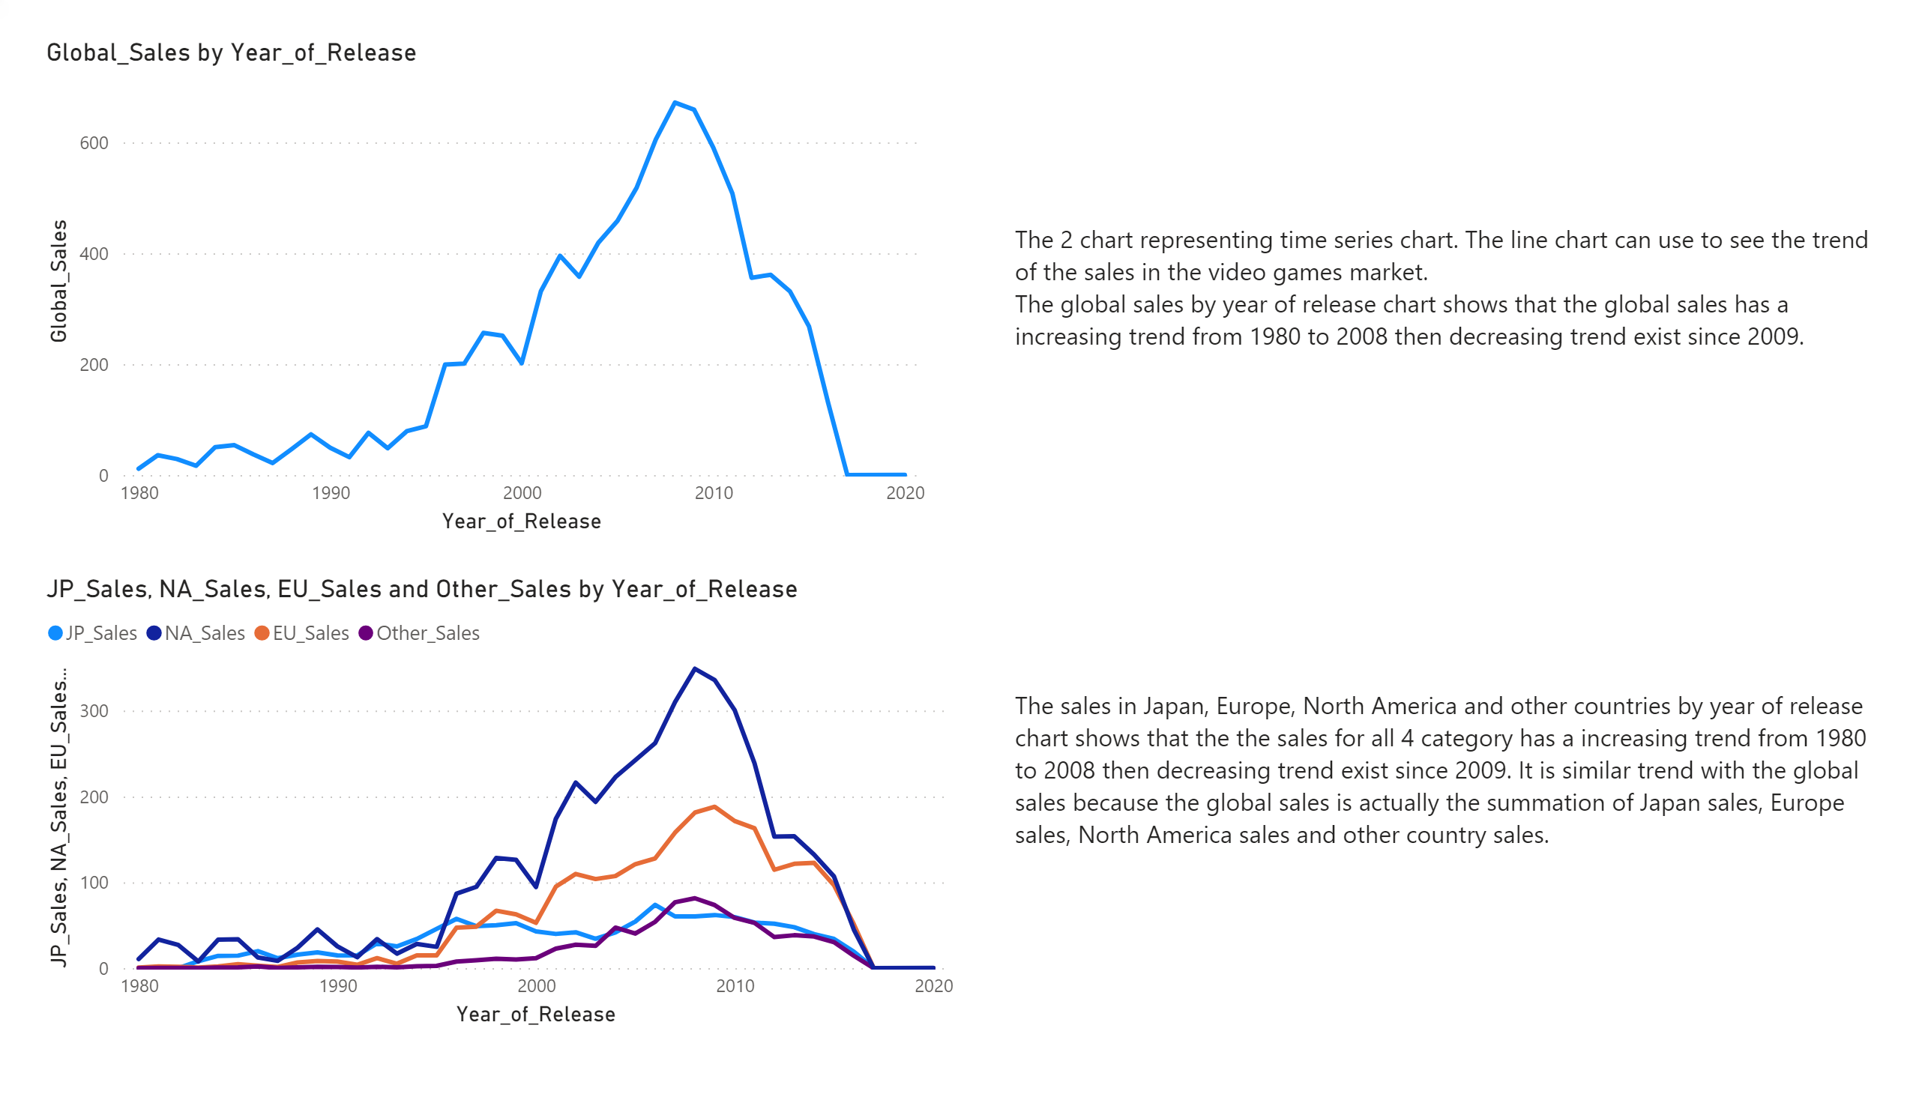
Sales by year
Notes:
textbox
No alt text provided.
textbox
No alt text provided.
lineChart
No alt text provided.
lineChart
No alt text provided.

Slide 4
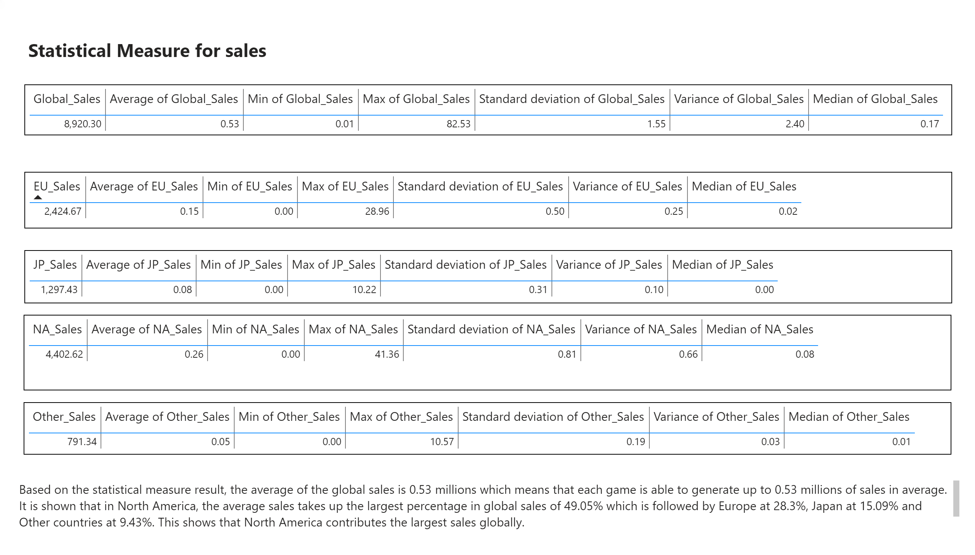
Statistical Measure for sales
Notes:
tableEx
No alt text provided.
tableEx
No alt text provided.
tableEx
No alt text provided.
tableEx
No alt text provided.
tableEx
No alt text provided.
textbox
No alt text provided.
textbox
No alt text provided.

Slide 5
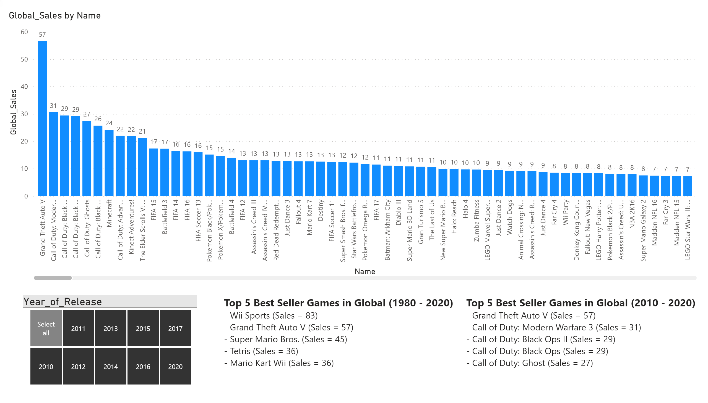
Global Sales by Games
Notes:
clusteredColumnChart
No alt text provided.
slicer
No alt text provided.
textbox
No alt text provided.
textbox
No alt text provided.

Slide 6
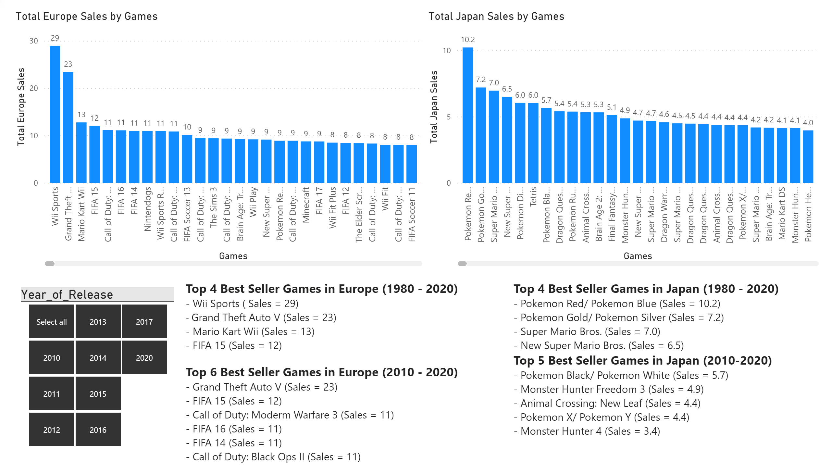
Sales by games (Europe and Japan)
Notes:
Total Europe Sales by Games
No alt text provided.
textbox
No alt text provided.
textbox
No alt text provided.
Total Japan Sales by Games
No alt text provided.
slicer
No alt text provided.

Slide 7
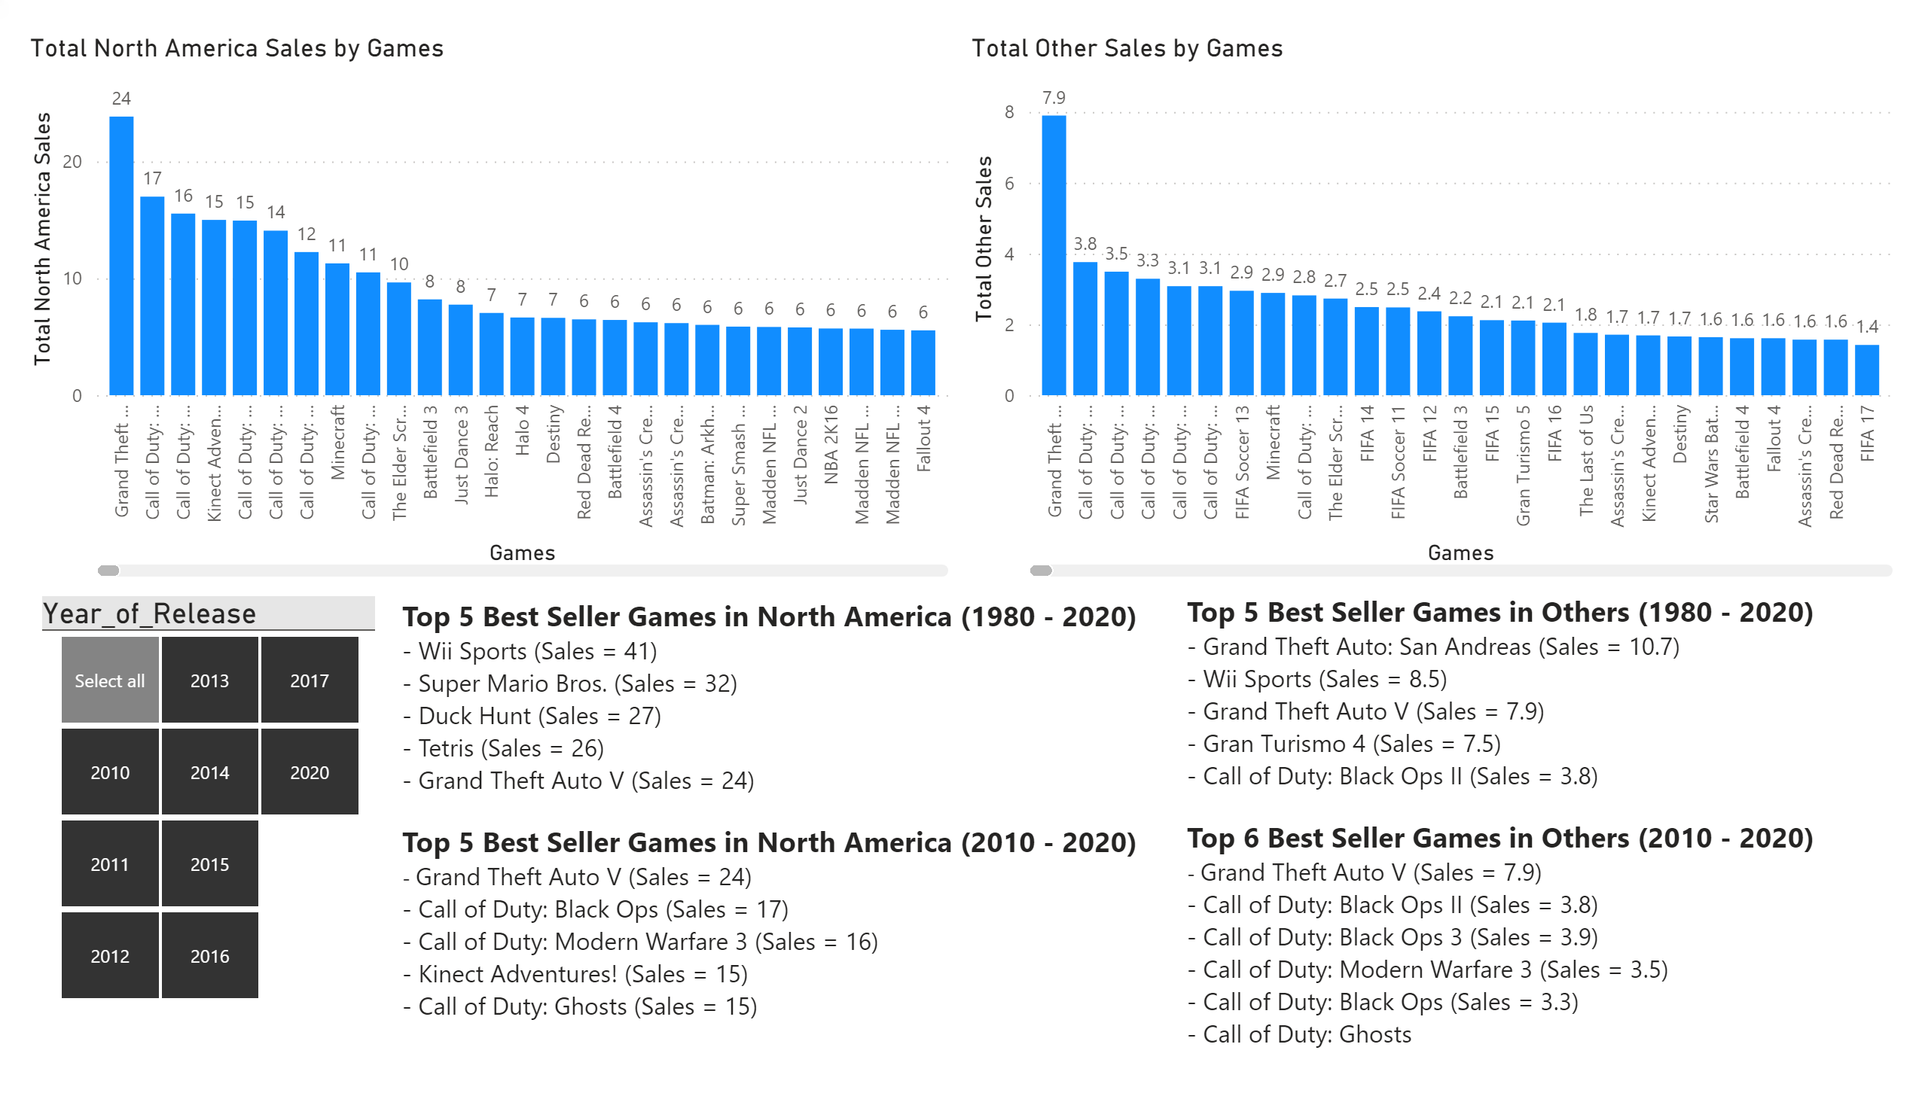
Sales by Games (North America and Others)
Notes:
textbox
No alt text provided.
textbox
No alt text provided.
clusteredColumnChart
No alt text provided.
clusteredColumnChart
No alt text provided.
slicer
No alt text provided.

Slide 8
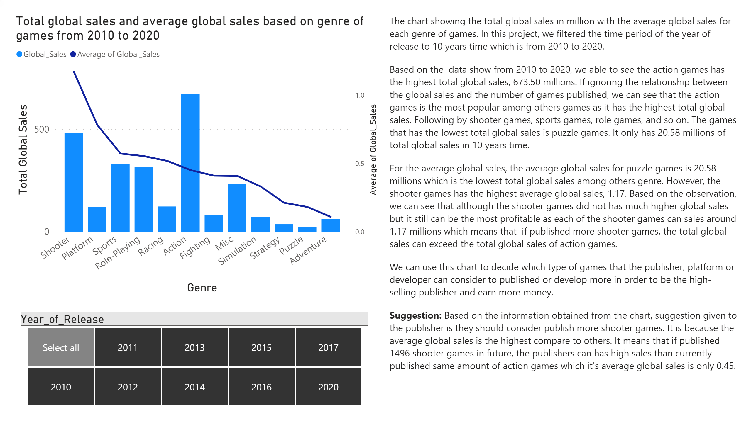
Total global sales and average by genre
Notes:
textbox
No alt text provided.
slicer
No alt text provided.
Total global sales and average global sales based on genre of games from 2010 to 2020
No alt text provided.

Slide 9
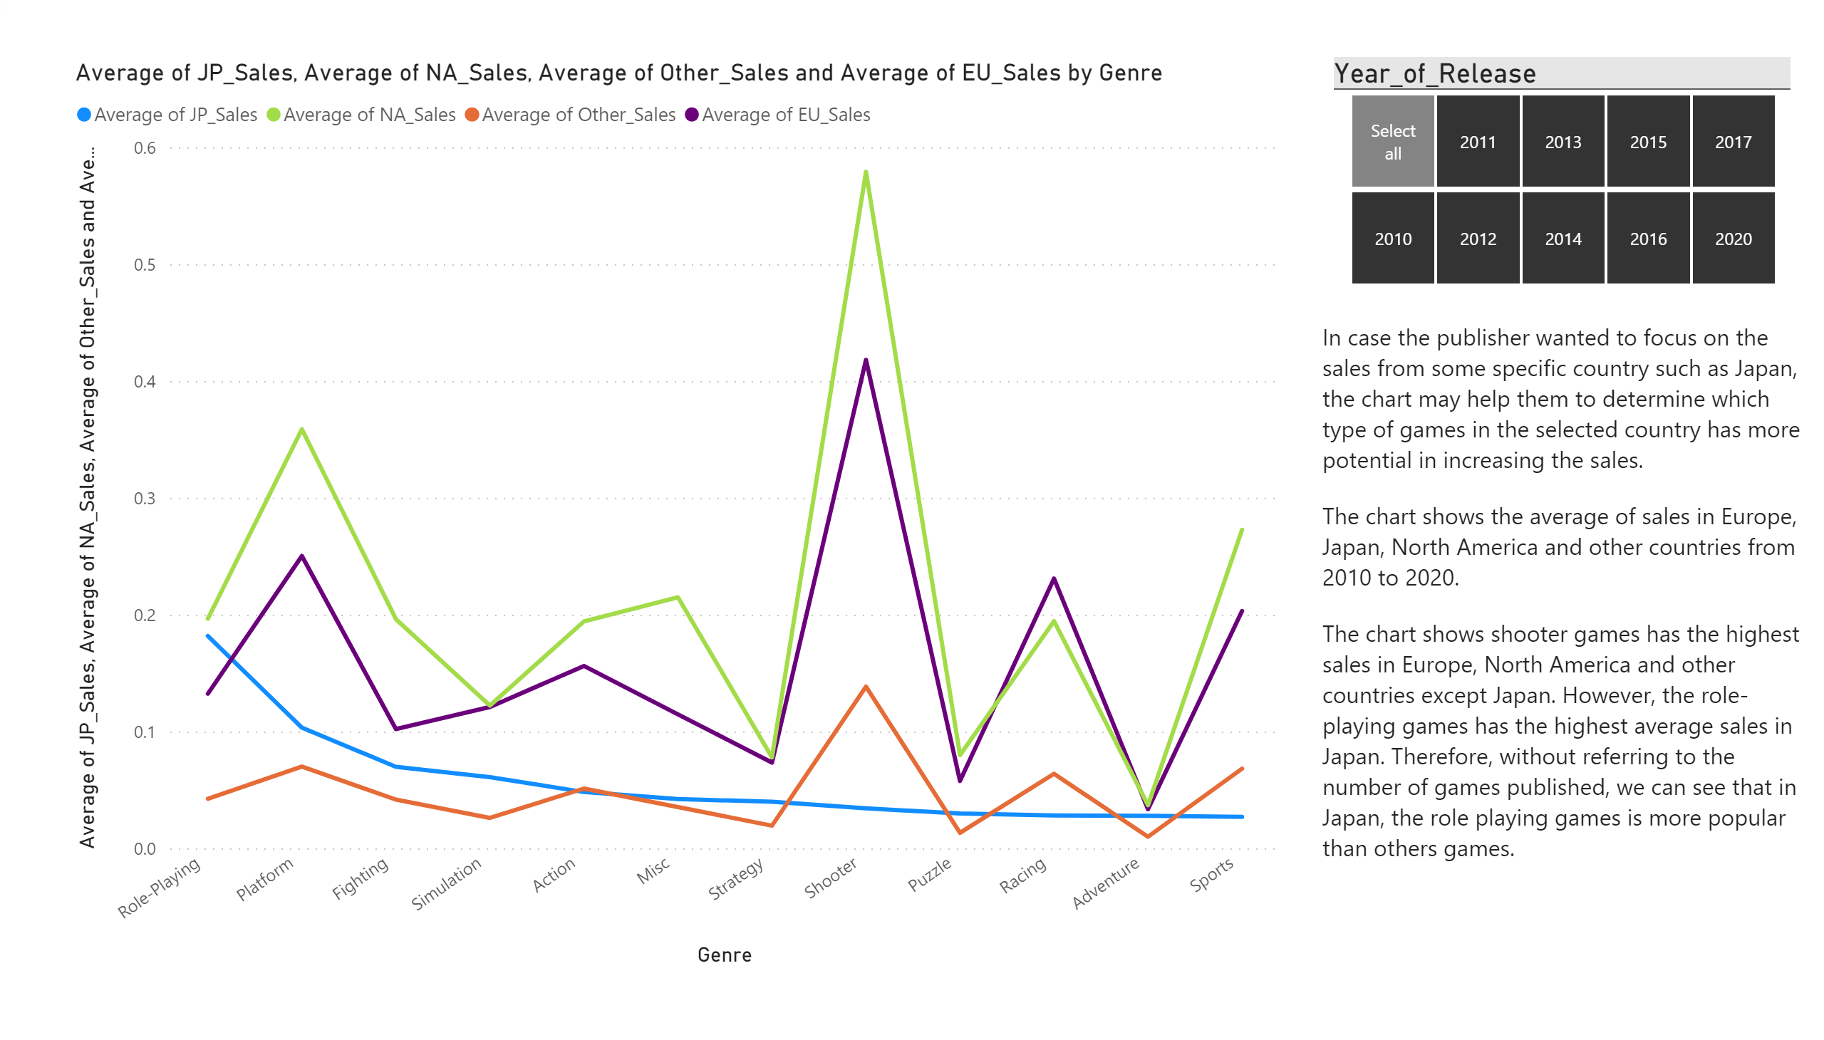
Total sales and average by genre
Notes:
slicer
No alt text provided.
lineChart
No alt text provided.
textbox
No alt text provided.

Slide 10
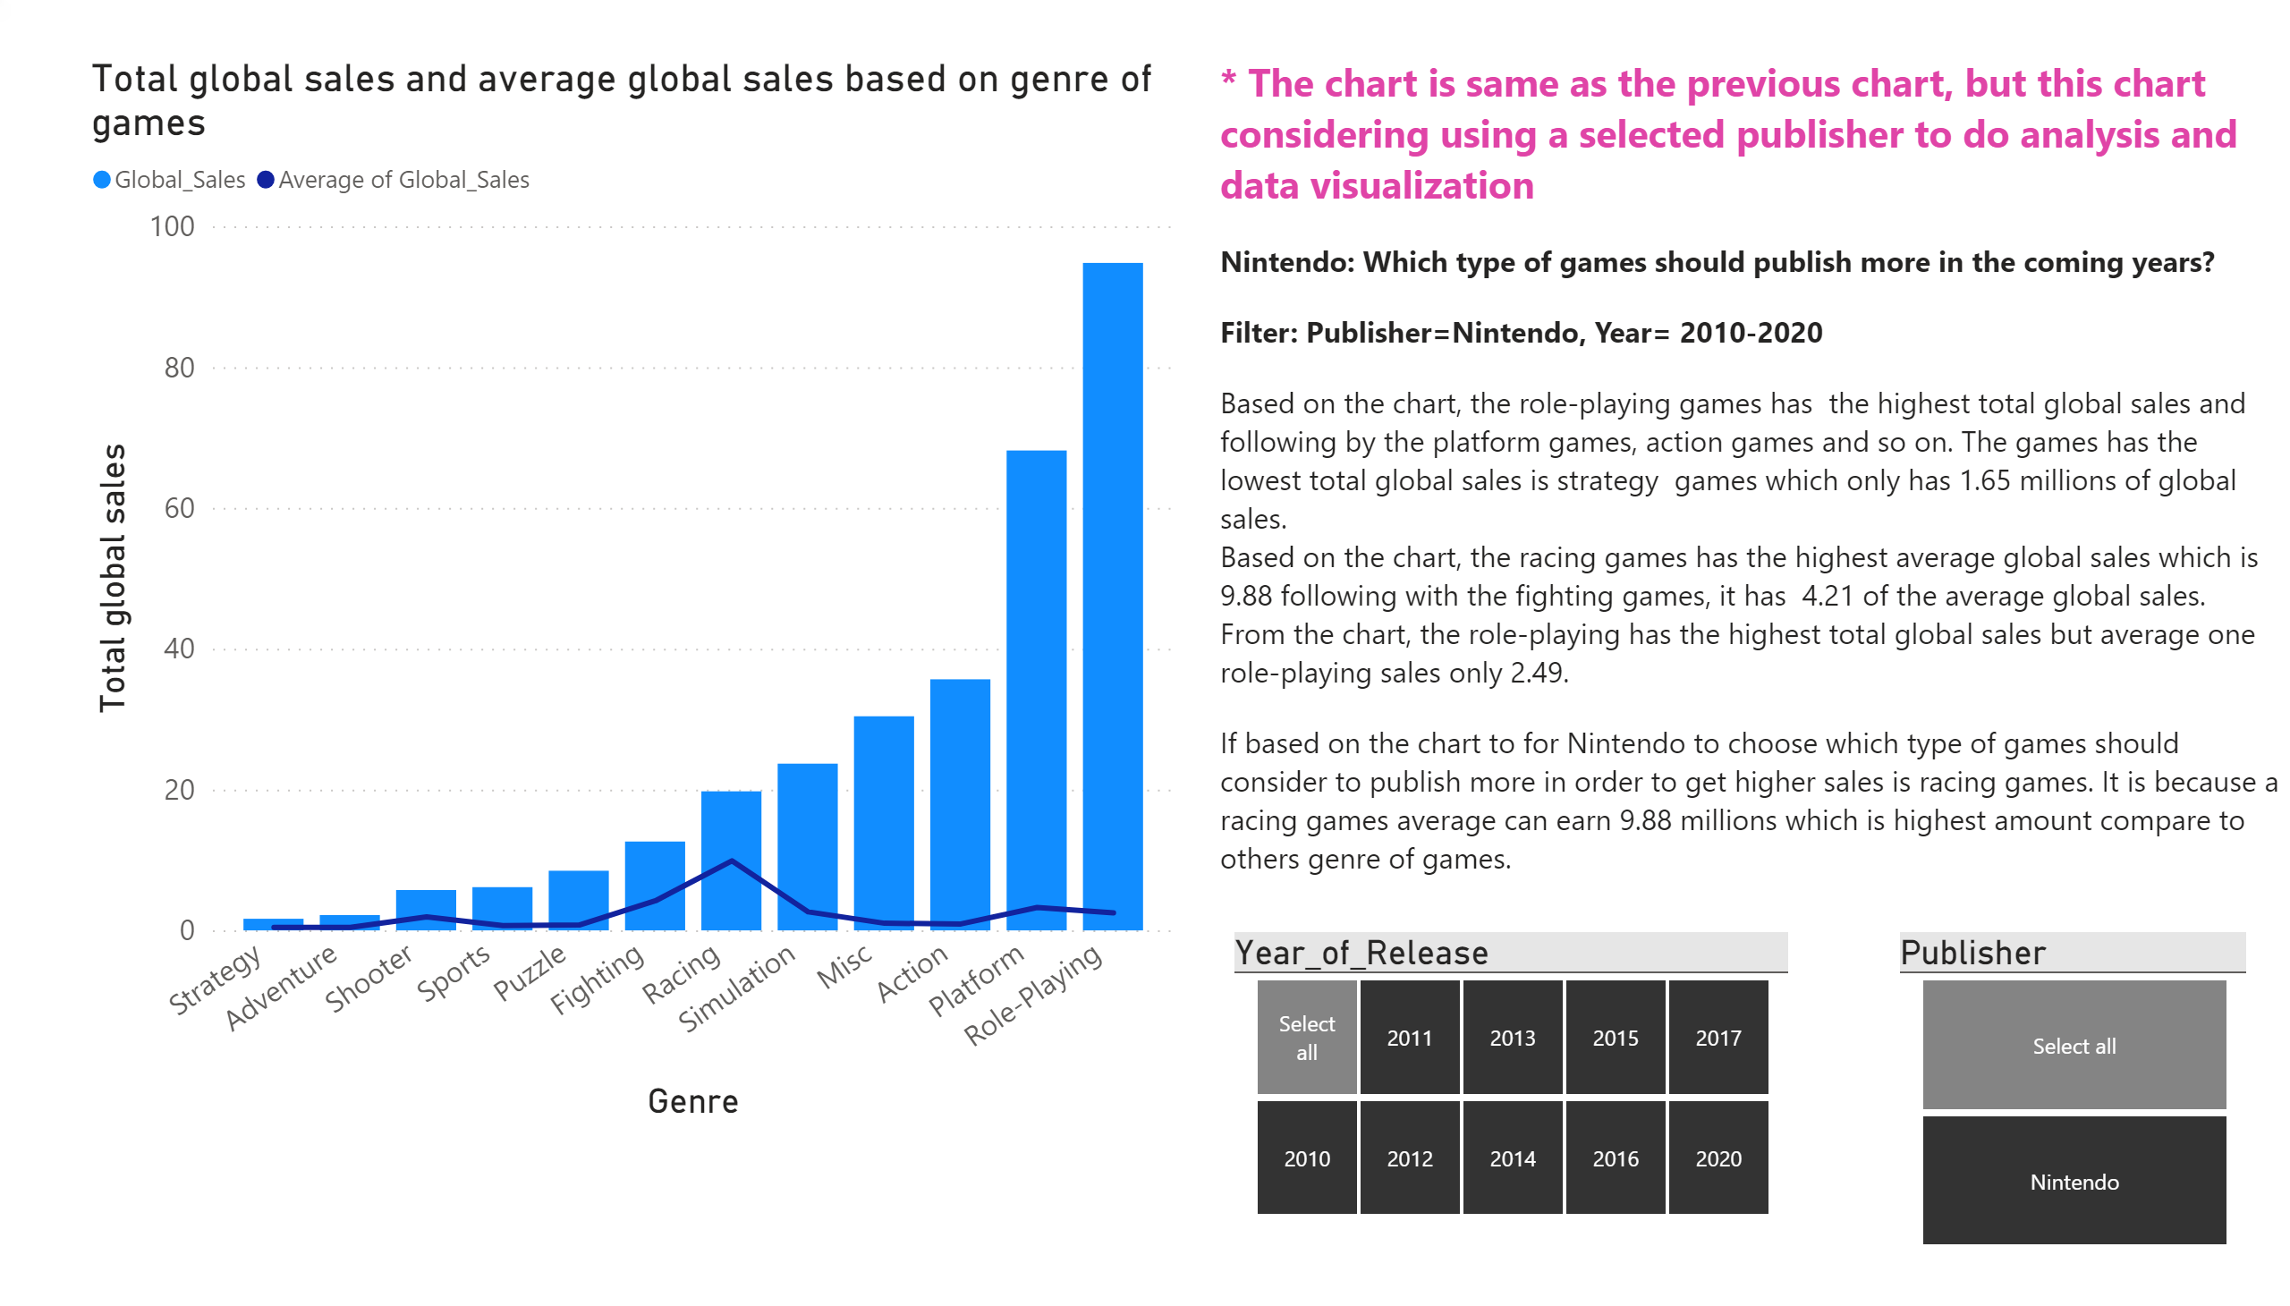
(Genre) Nintendo
Notes:
slicer
No alt text provided.
textbox
No alt text provided.
Total global sales and average global sales based on genre of games
No alt text provided.
slicer
No alt text provided.

Slide 11
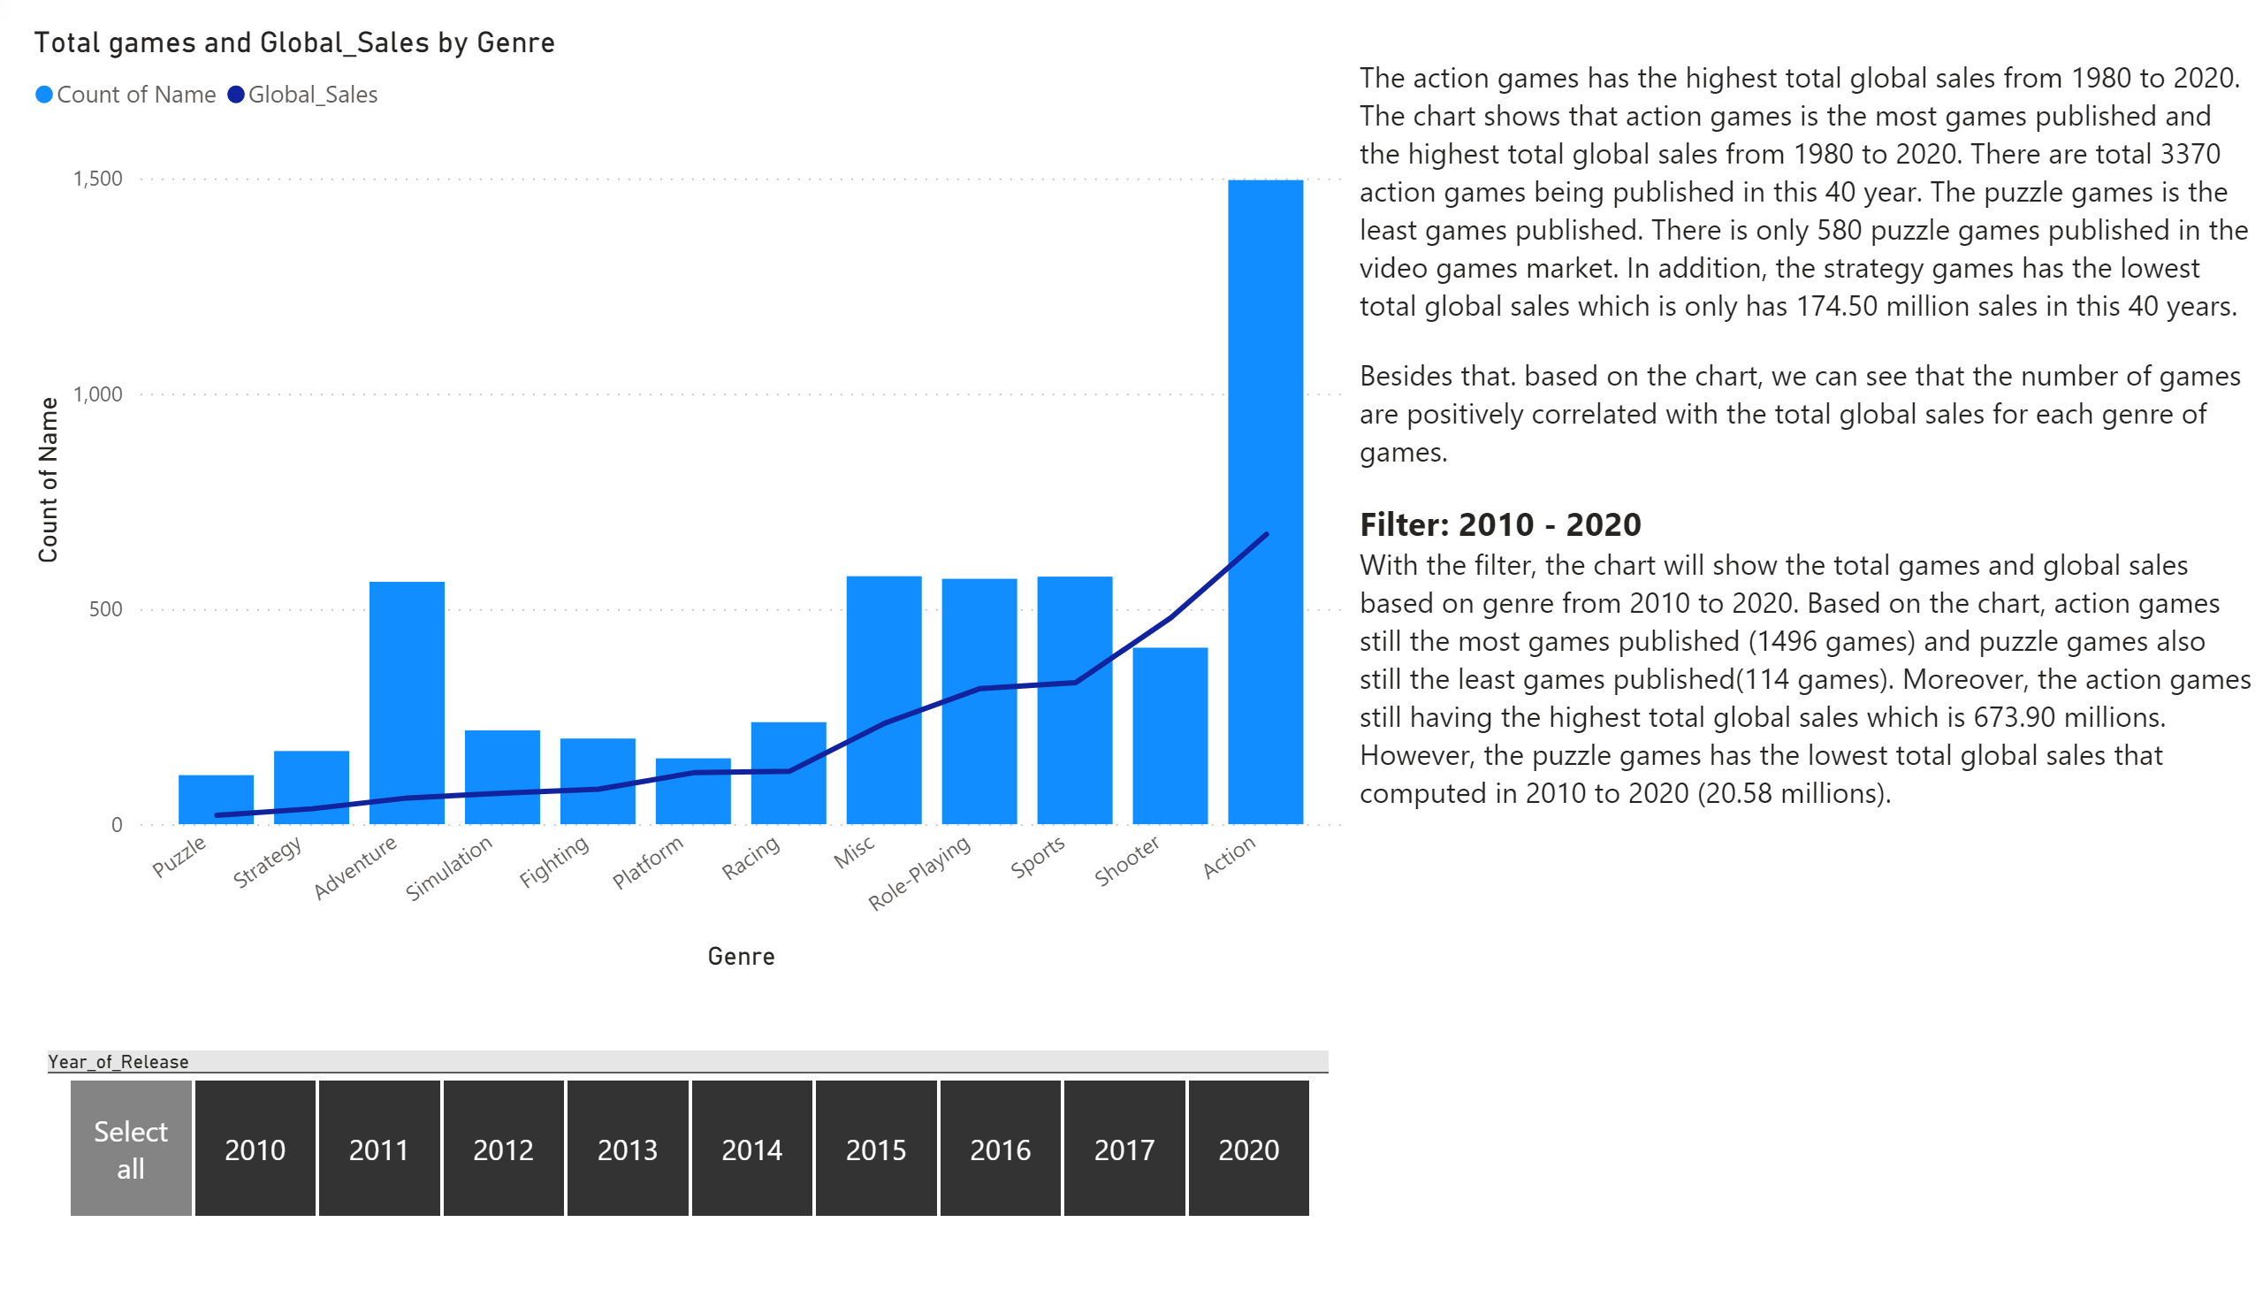
Total games and global sales by genre
Notes:
Total games and Global_Sales by Genre
No alt text provided.
textbox
No alt text provided.
slicer
No alt text provided.

Slide 12
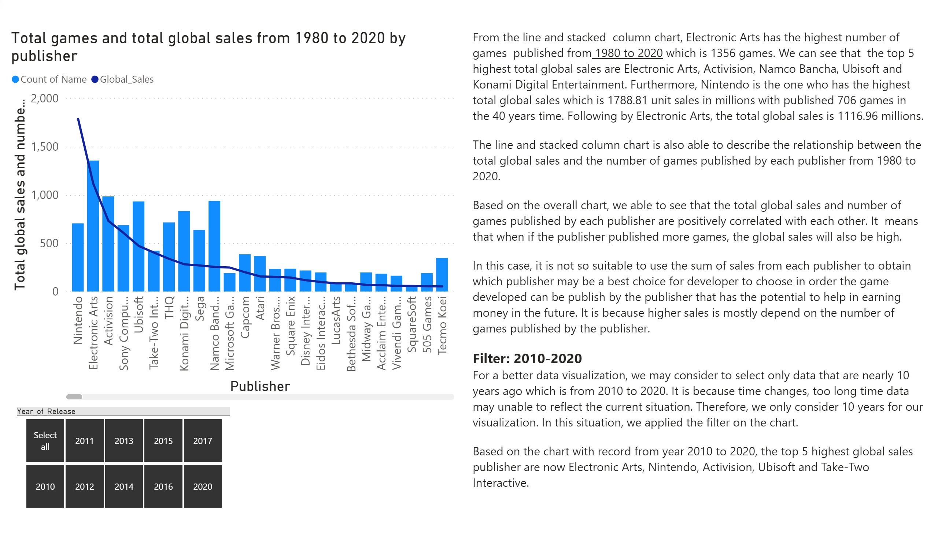
Total Global Sales by publisher
Notes:
textbox
No alt text provided.
Total games and total global sales from 1980 to 2020 by publisher
No alt text provided.
slicer
No alt text provided.

Slide 13
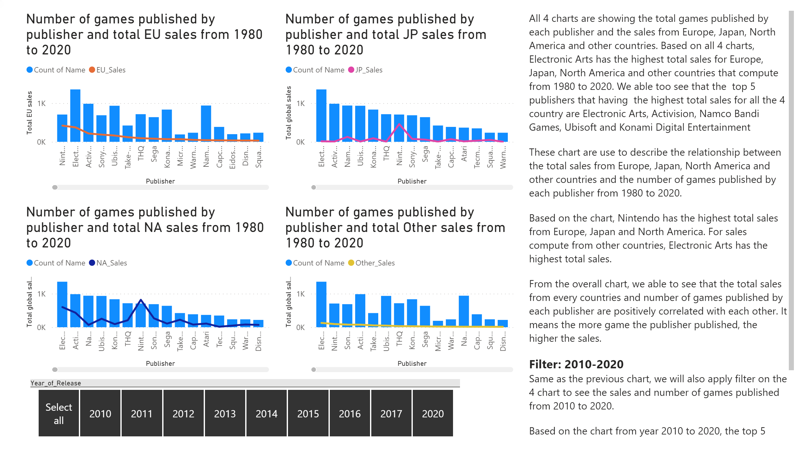
Total sales from other country by publisher
Notes:
Number of games published by publisher and total JP sales from 1980 to 2020
No alt text provided.
Number of games published by publisher and total EU sales from 1980 to 2020
No alt text provided.
textbox
No alt text provided.
Number of games published by publisher and total Other sales from 1980 to 2020
No alt text provided.
Number of games published by publisher and total NA sales from 1980 to 2020
No alt text provided.
slicer
No alt text provided.

Slide 14
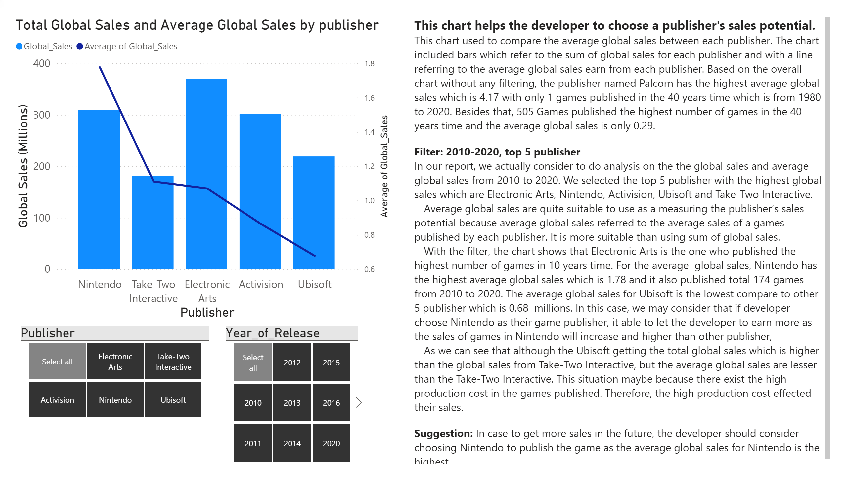
Total Global Sales and Average global sales by publisher
Notes:
textbox
No alt text provided.
Total Global Sales and Average Global Sales by publisher
No alt text provided.
slicer
No alt text provided.
slicer
No alt text provided.

Slide 15
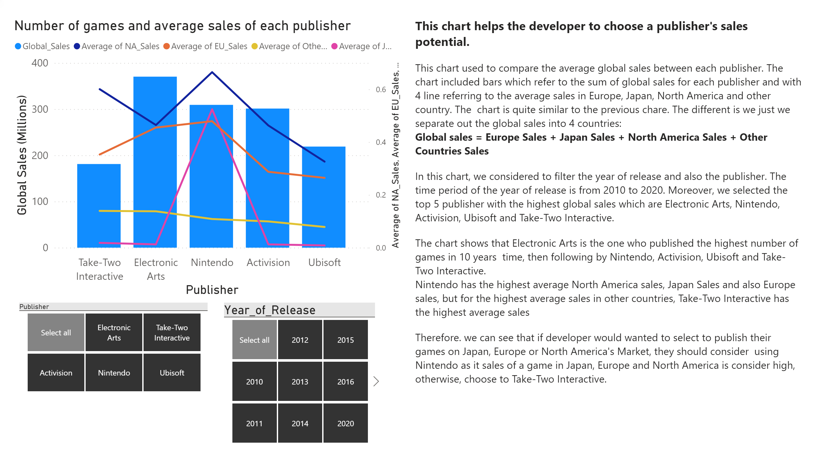
Average sales from other country by publisher
Notes:
slicer
No alt text provided.
slicer
No alt text provided.
Number of games and average sales of each publisher
No alt text provided.
textbox
No alt text provided.

Slide 16
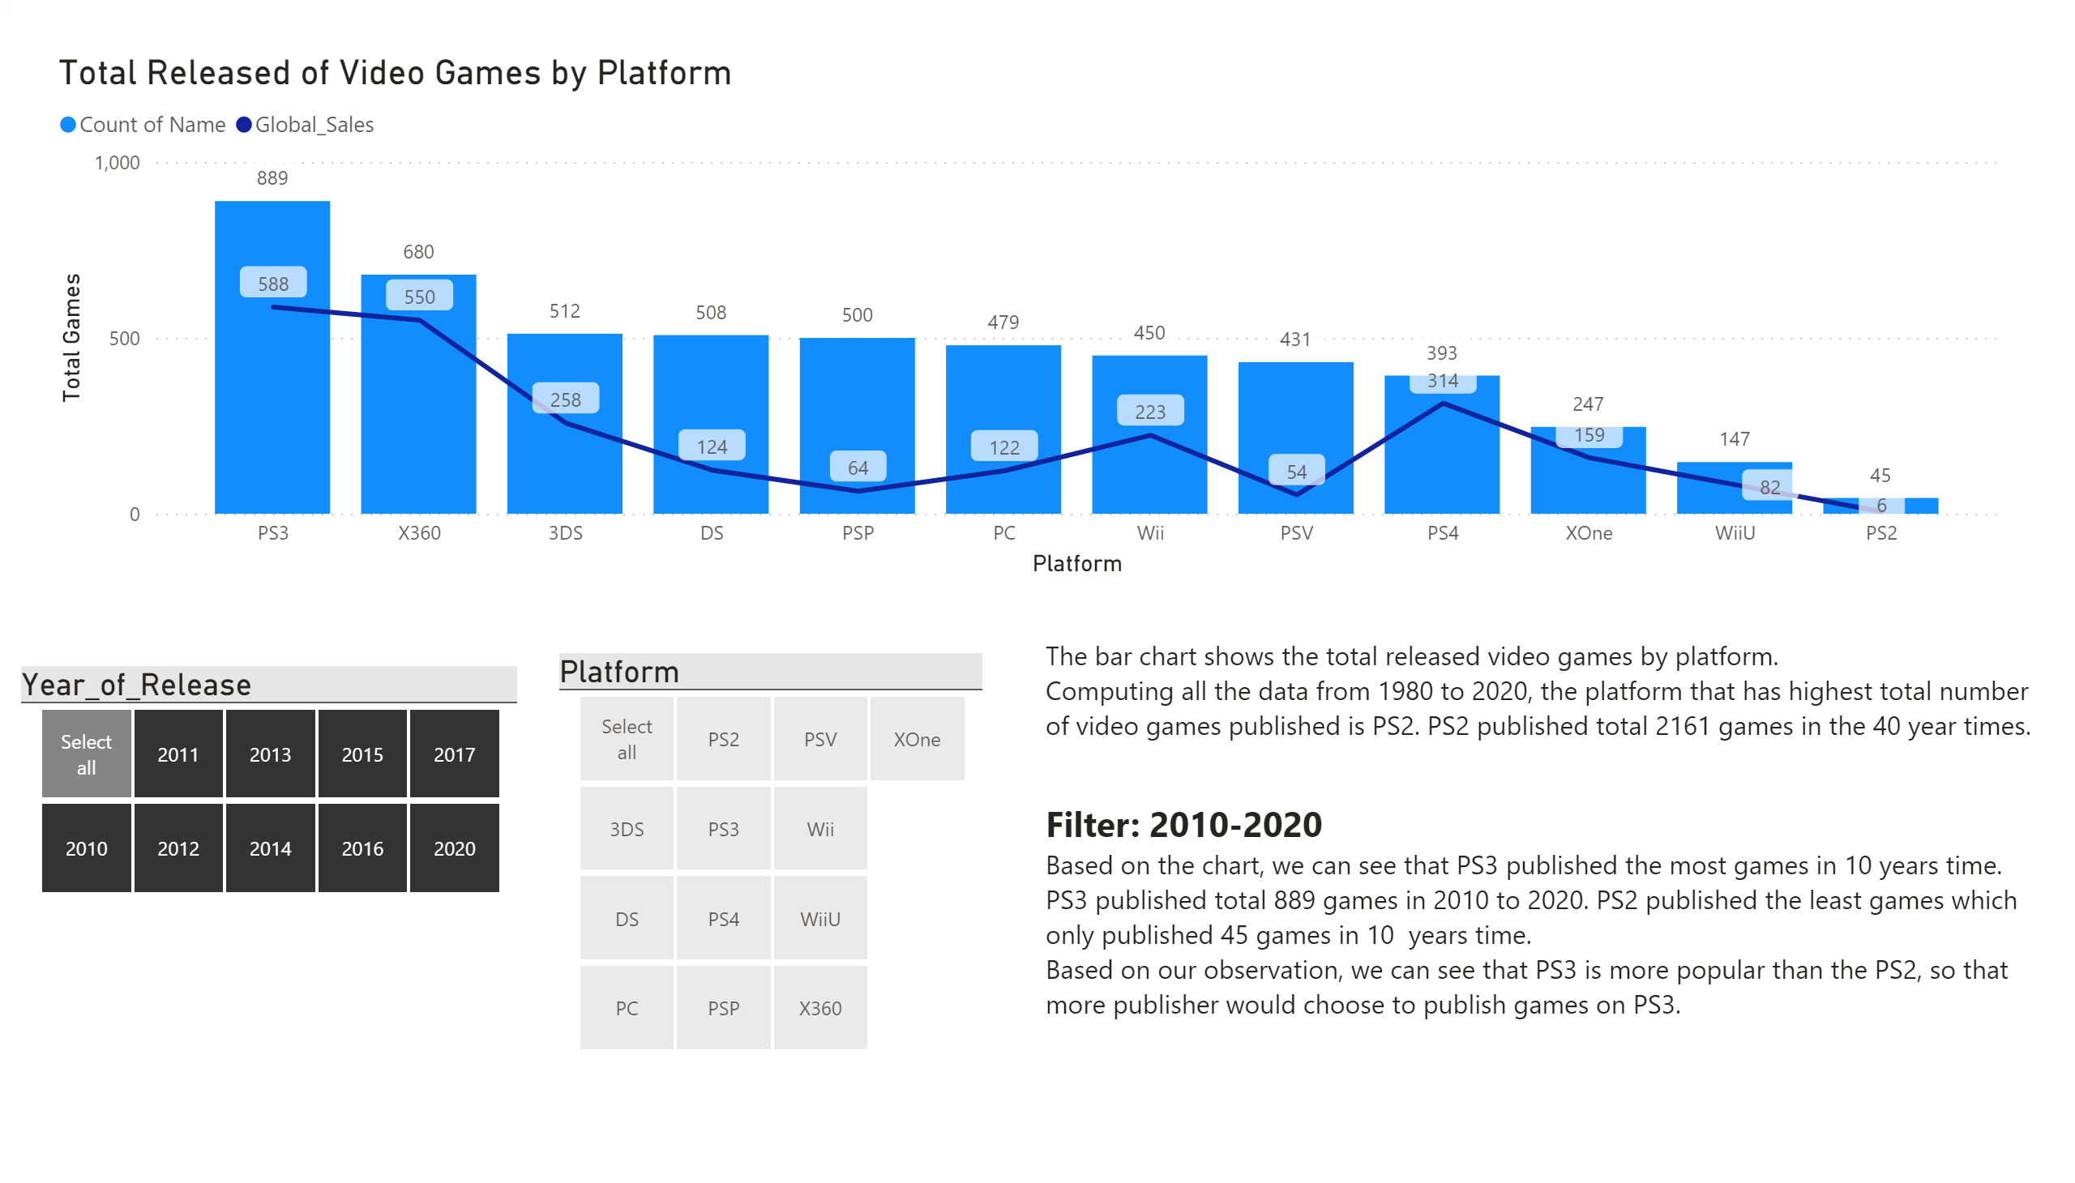
Total Released of Video Games and global sales by Platform
Notes:
Total Released of Video Games by Platform
No alt text provided.
slicer
No alt text provided.
textbox
No alt text provided.
slicer
No alt text provided.

Slide 17
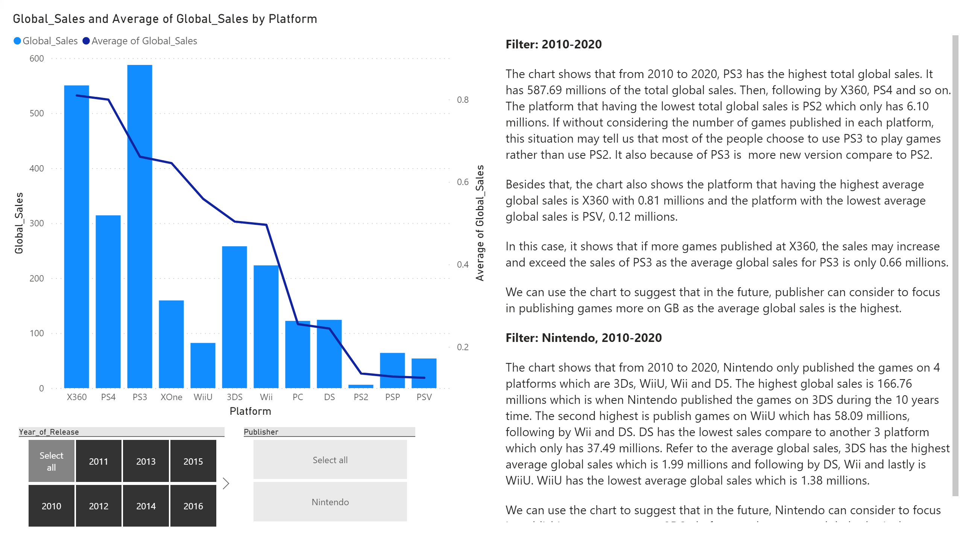
Total global sales and average by platform
Notes:
textbox
No alt text provided.
slicer
No alt text provided.
lineStackedColumnComboChart
No alt text provided.
slicer
No alt text provided.

Slide 18
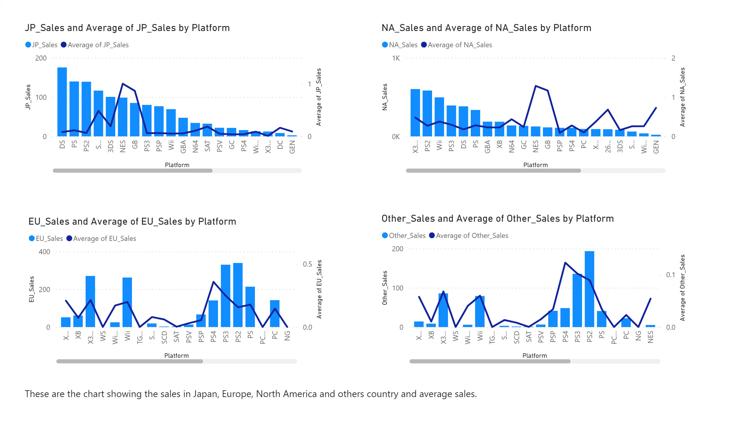
(Platform) Total Sales with average
Notes:
lineStackedColumnComboChart
No alt text provided.
lineStackedColumnComboChart
No alt text provided.
lineStackedColumnComboChart
No alt text provided.
lineStackedColumnComboChart
No alt text provided.
textbox
No alt text provided.

Slide 19
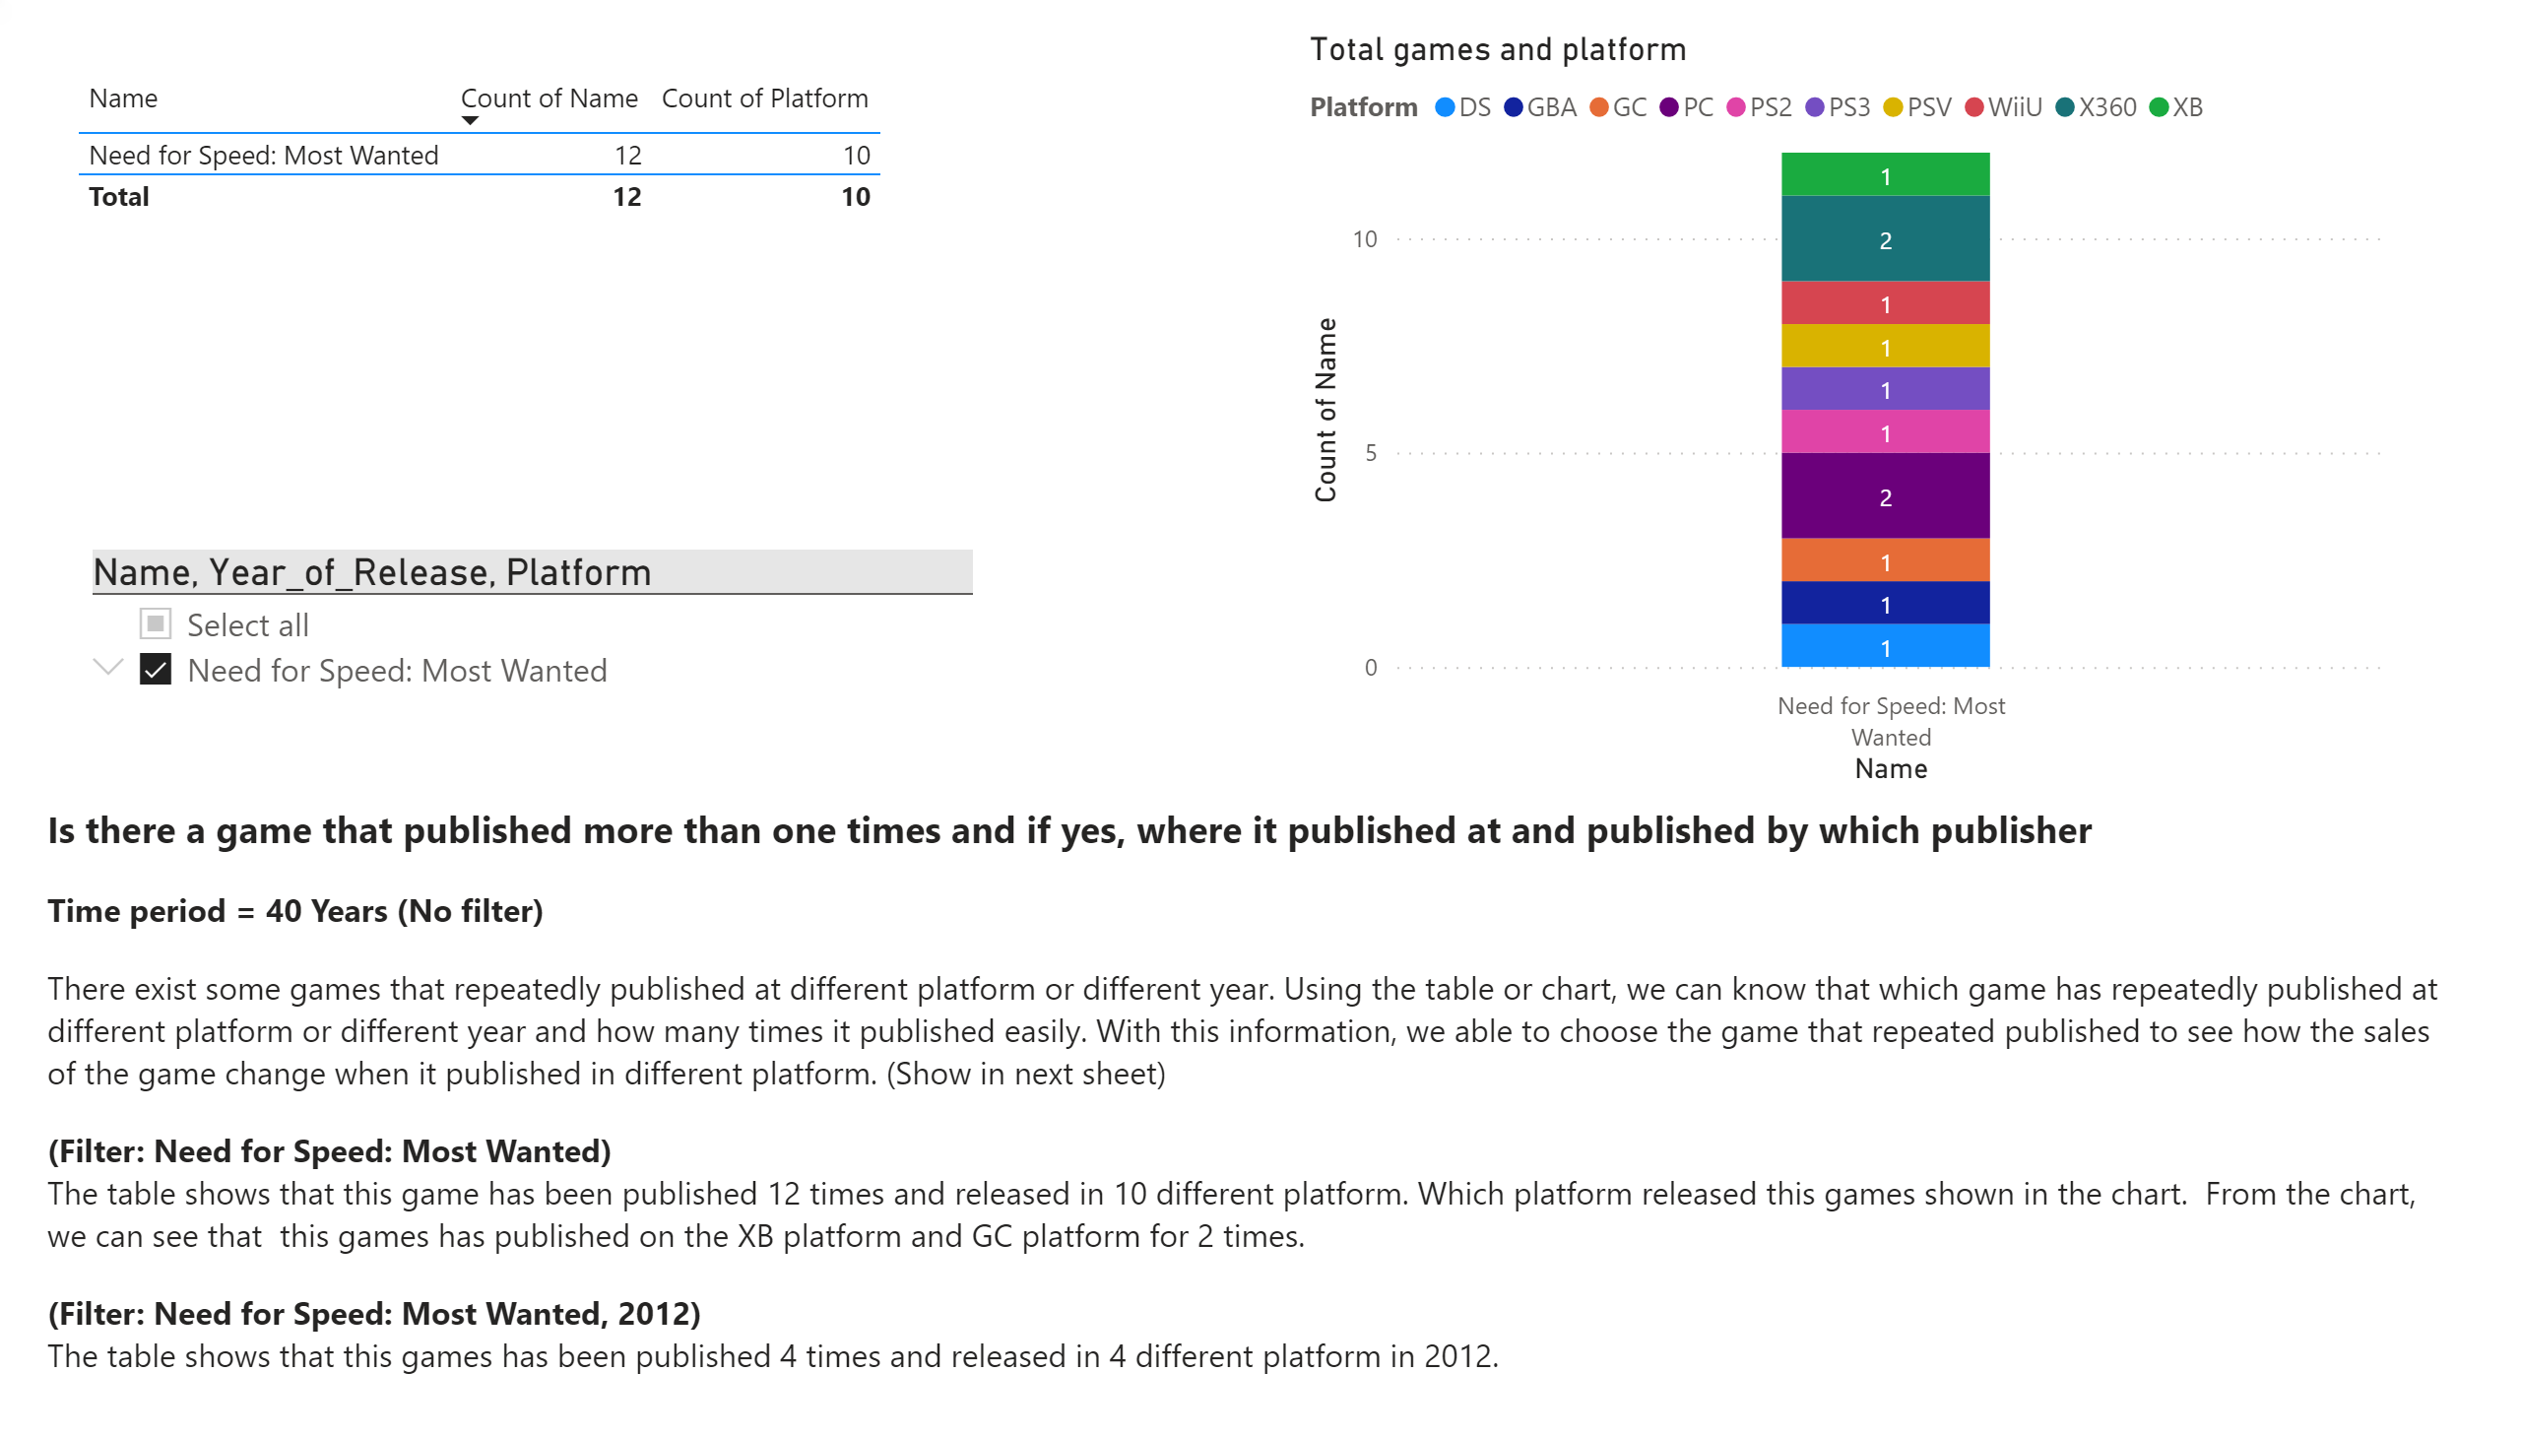
Repeated games
Notes:
slicer
No alt text provided.
textbox
No alt text provided.
Total games and platform
No alt text provided.
tableEx
No alt text provided.

Slide 20
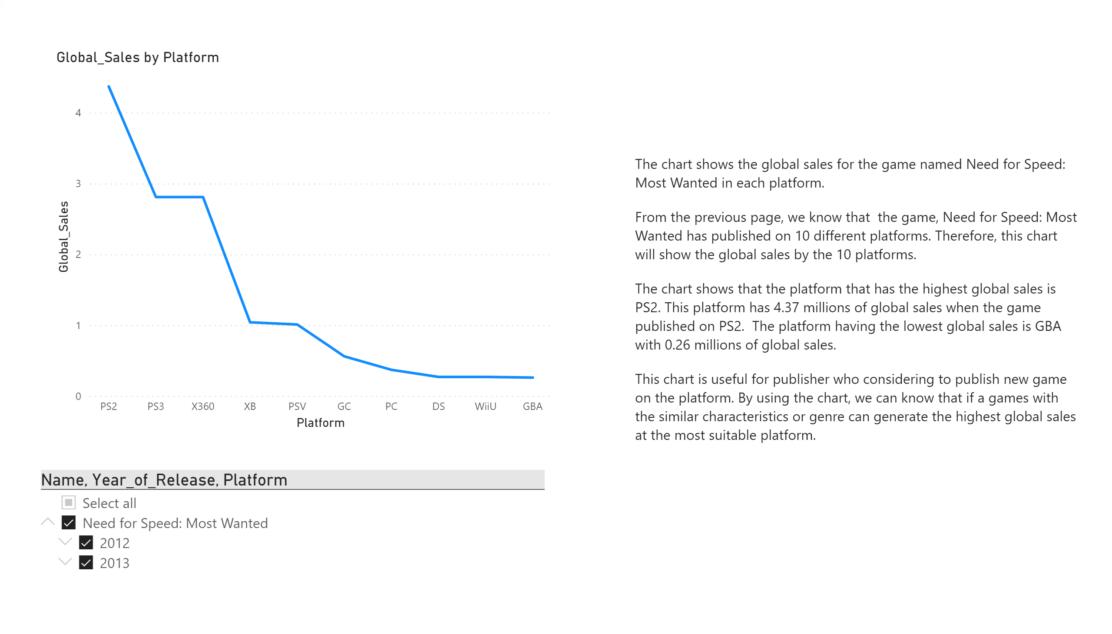
Explain the table
Notes:
slicer
No alt text provided.
lineChart
No alt text provided.
textbox
No alt text provided.

Slide 21
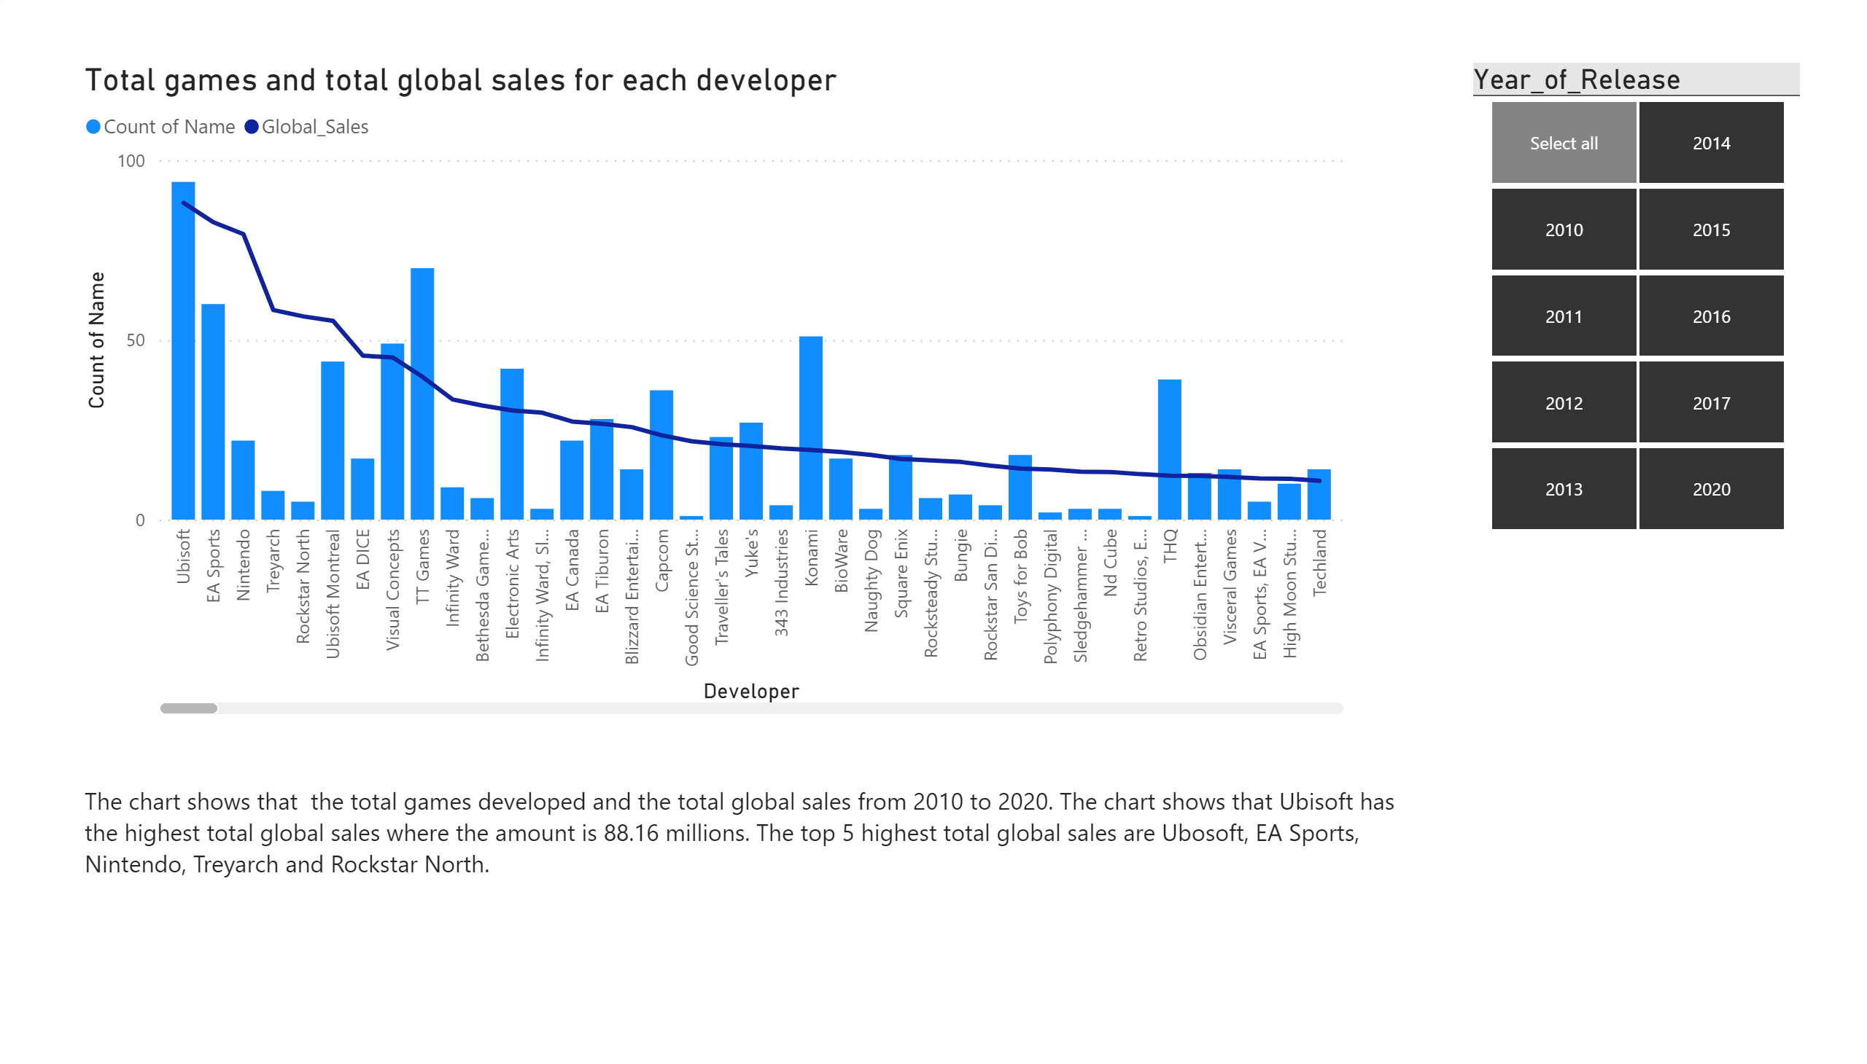
Developer
Notes:
Total games and total global sales for each developer
No alt text provided.
textbox
No alt text provided.
slicer
No alt text provided.

Slide 22
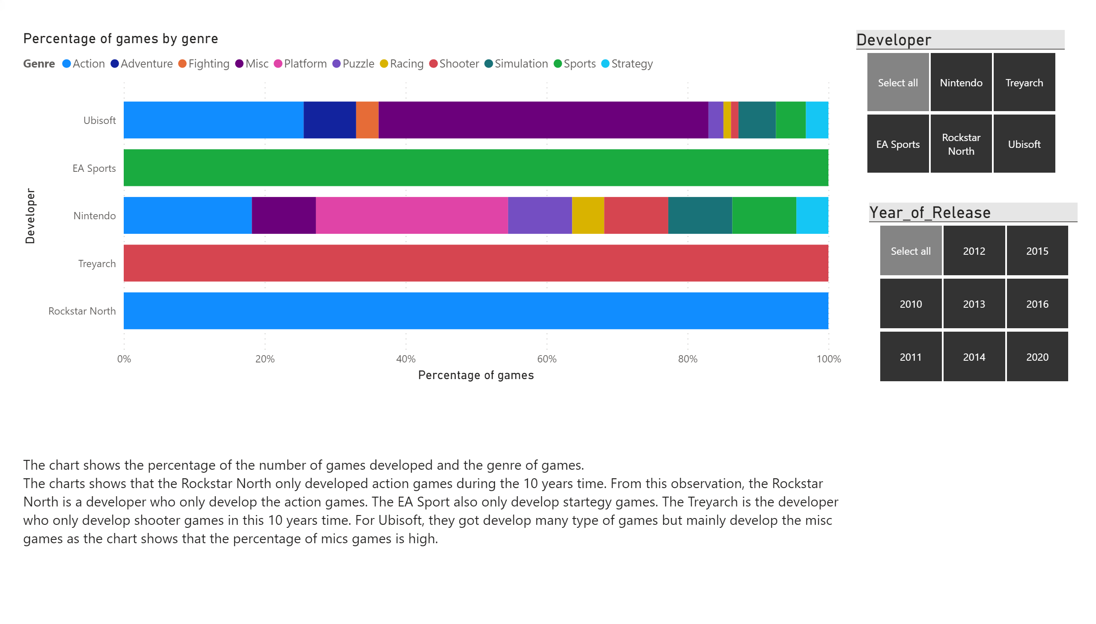
Developer and genre
Notes:
slicer
No alt text provided.
Percentage of games by genre
No alt text provided.
slicer
No alt text provided.
textbox
No alt text provided.

Slide 23
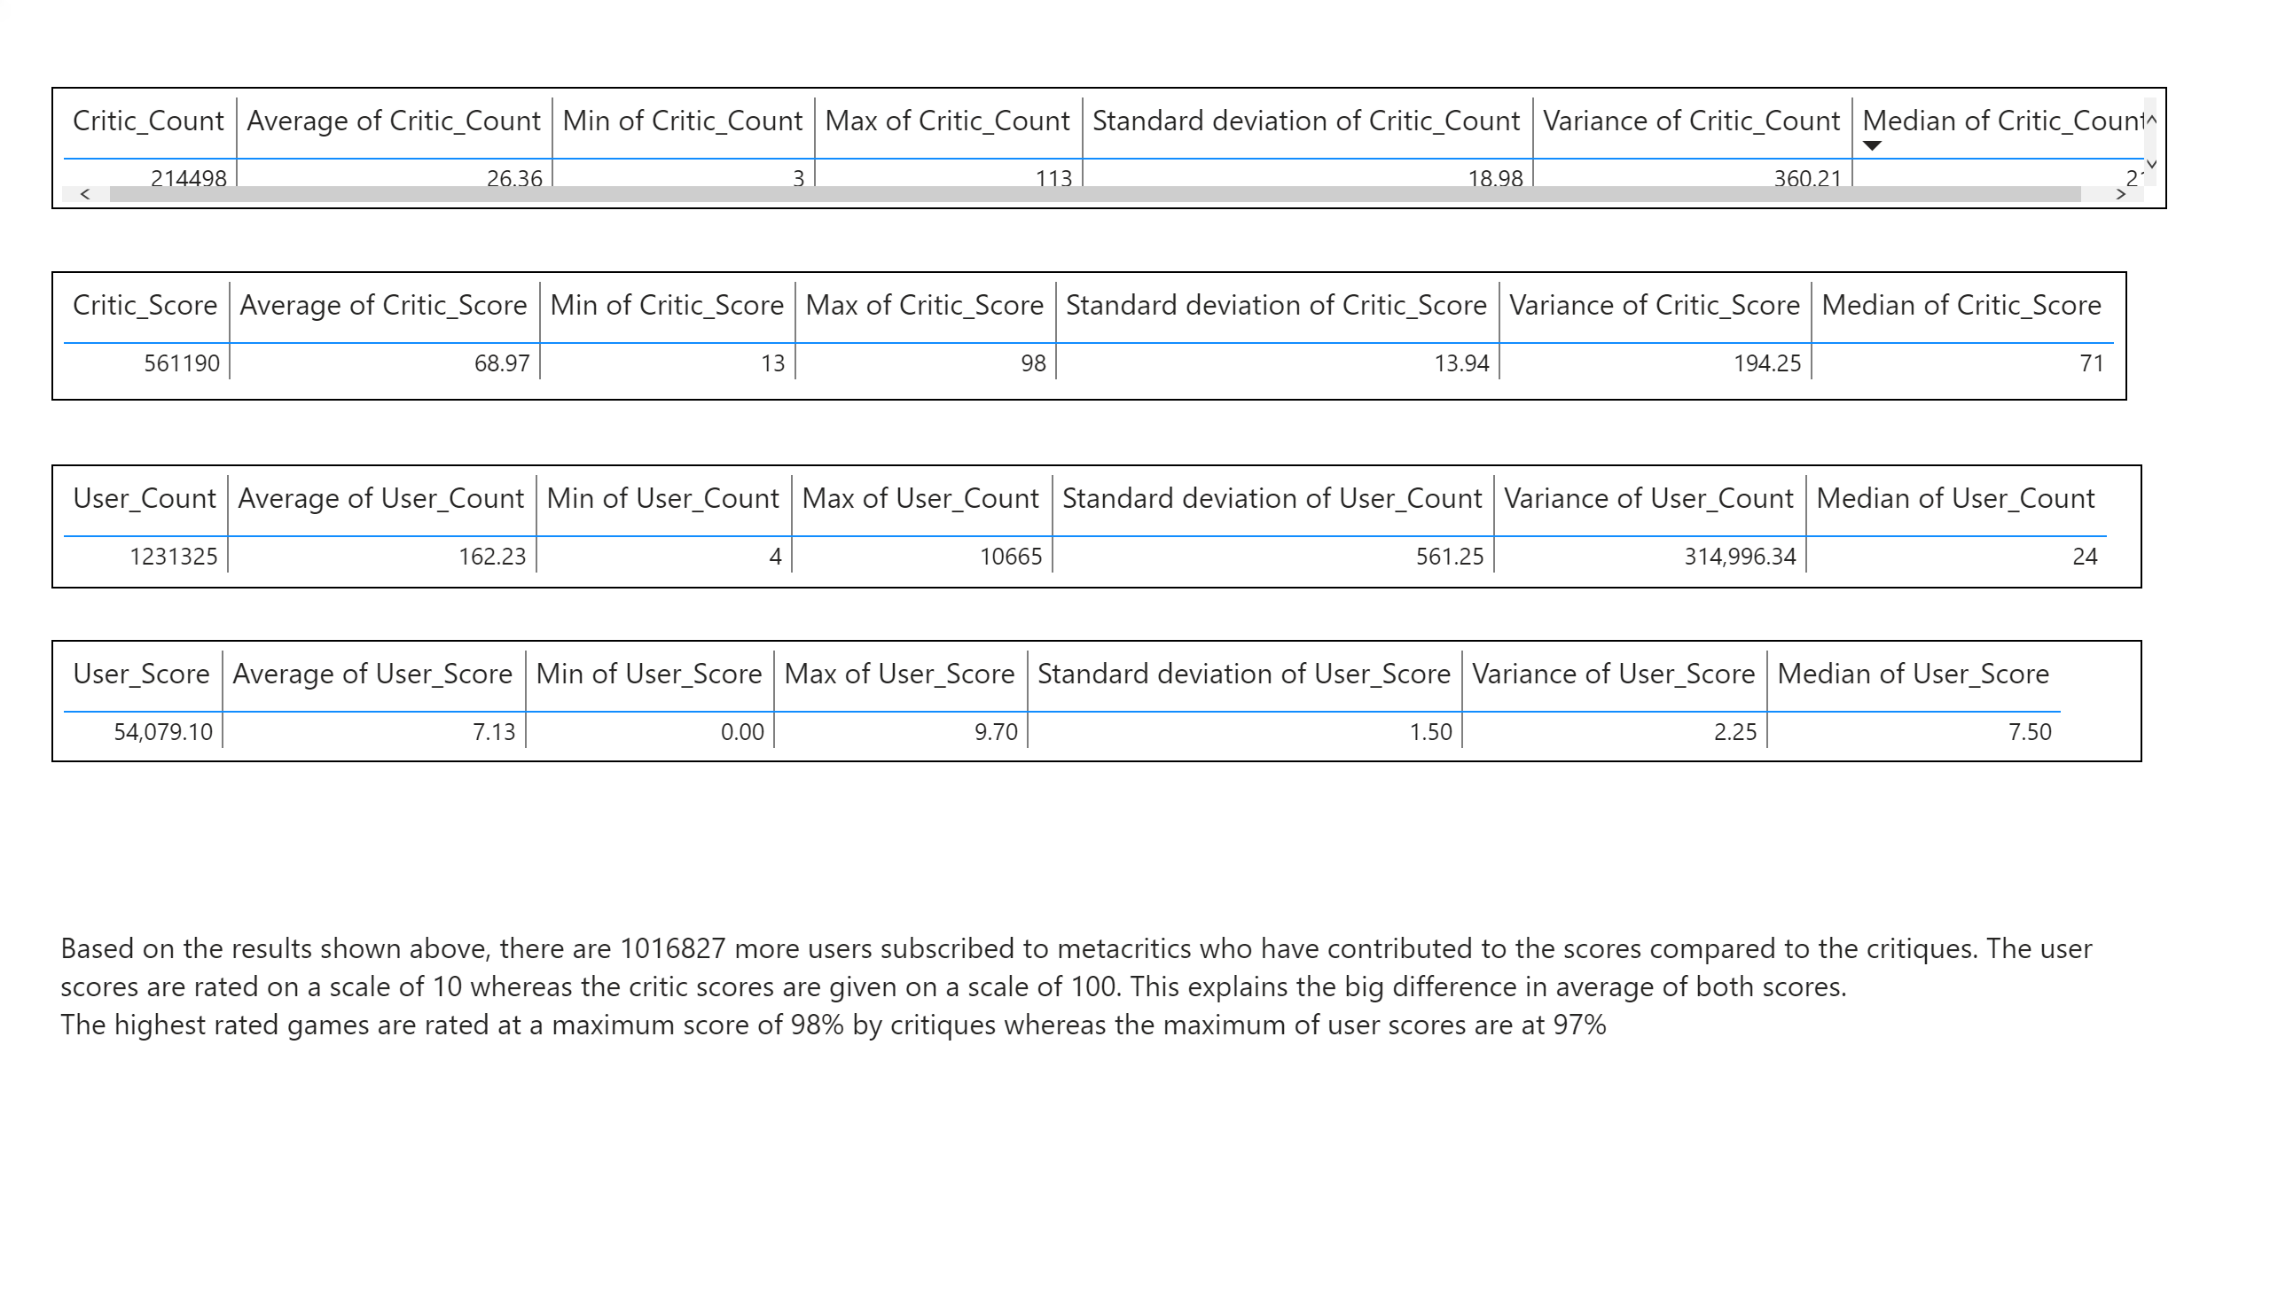
Statistical Measure by count and score
Notes:
tableEx
No alt text provided.
tableEx
No alt text provided.
tableEx
No alt text provided.
tableEx
No alt text provided.
textbox
No alt text provided.

Slide 24
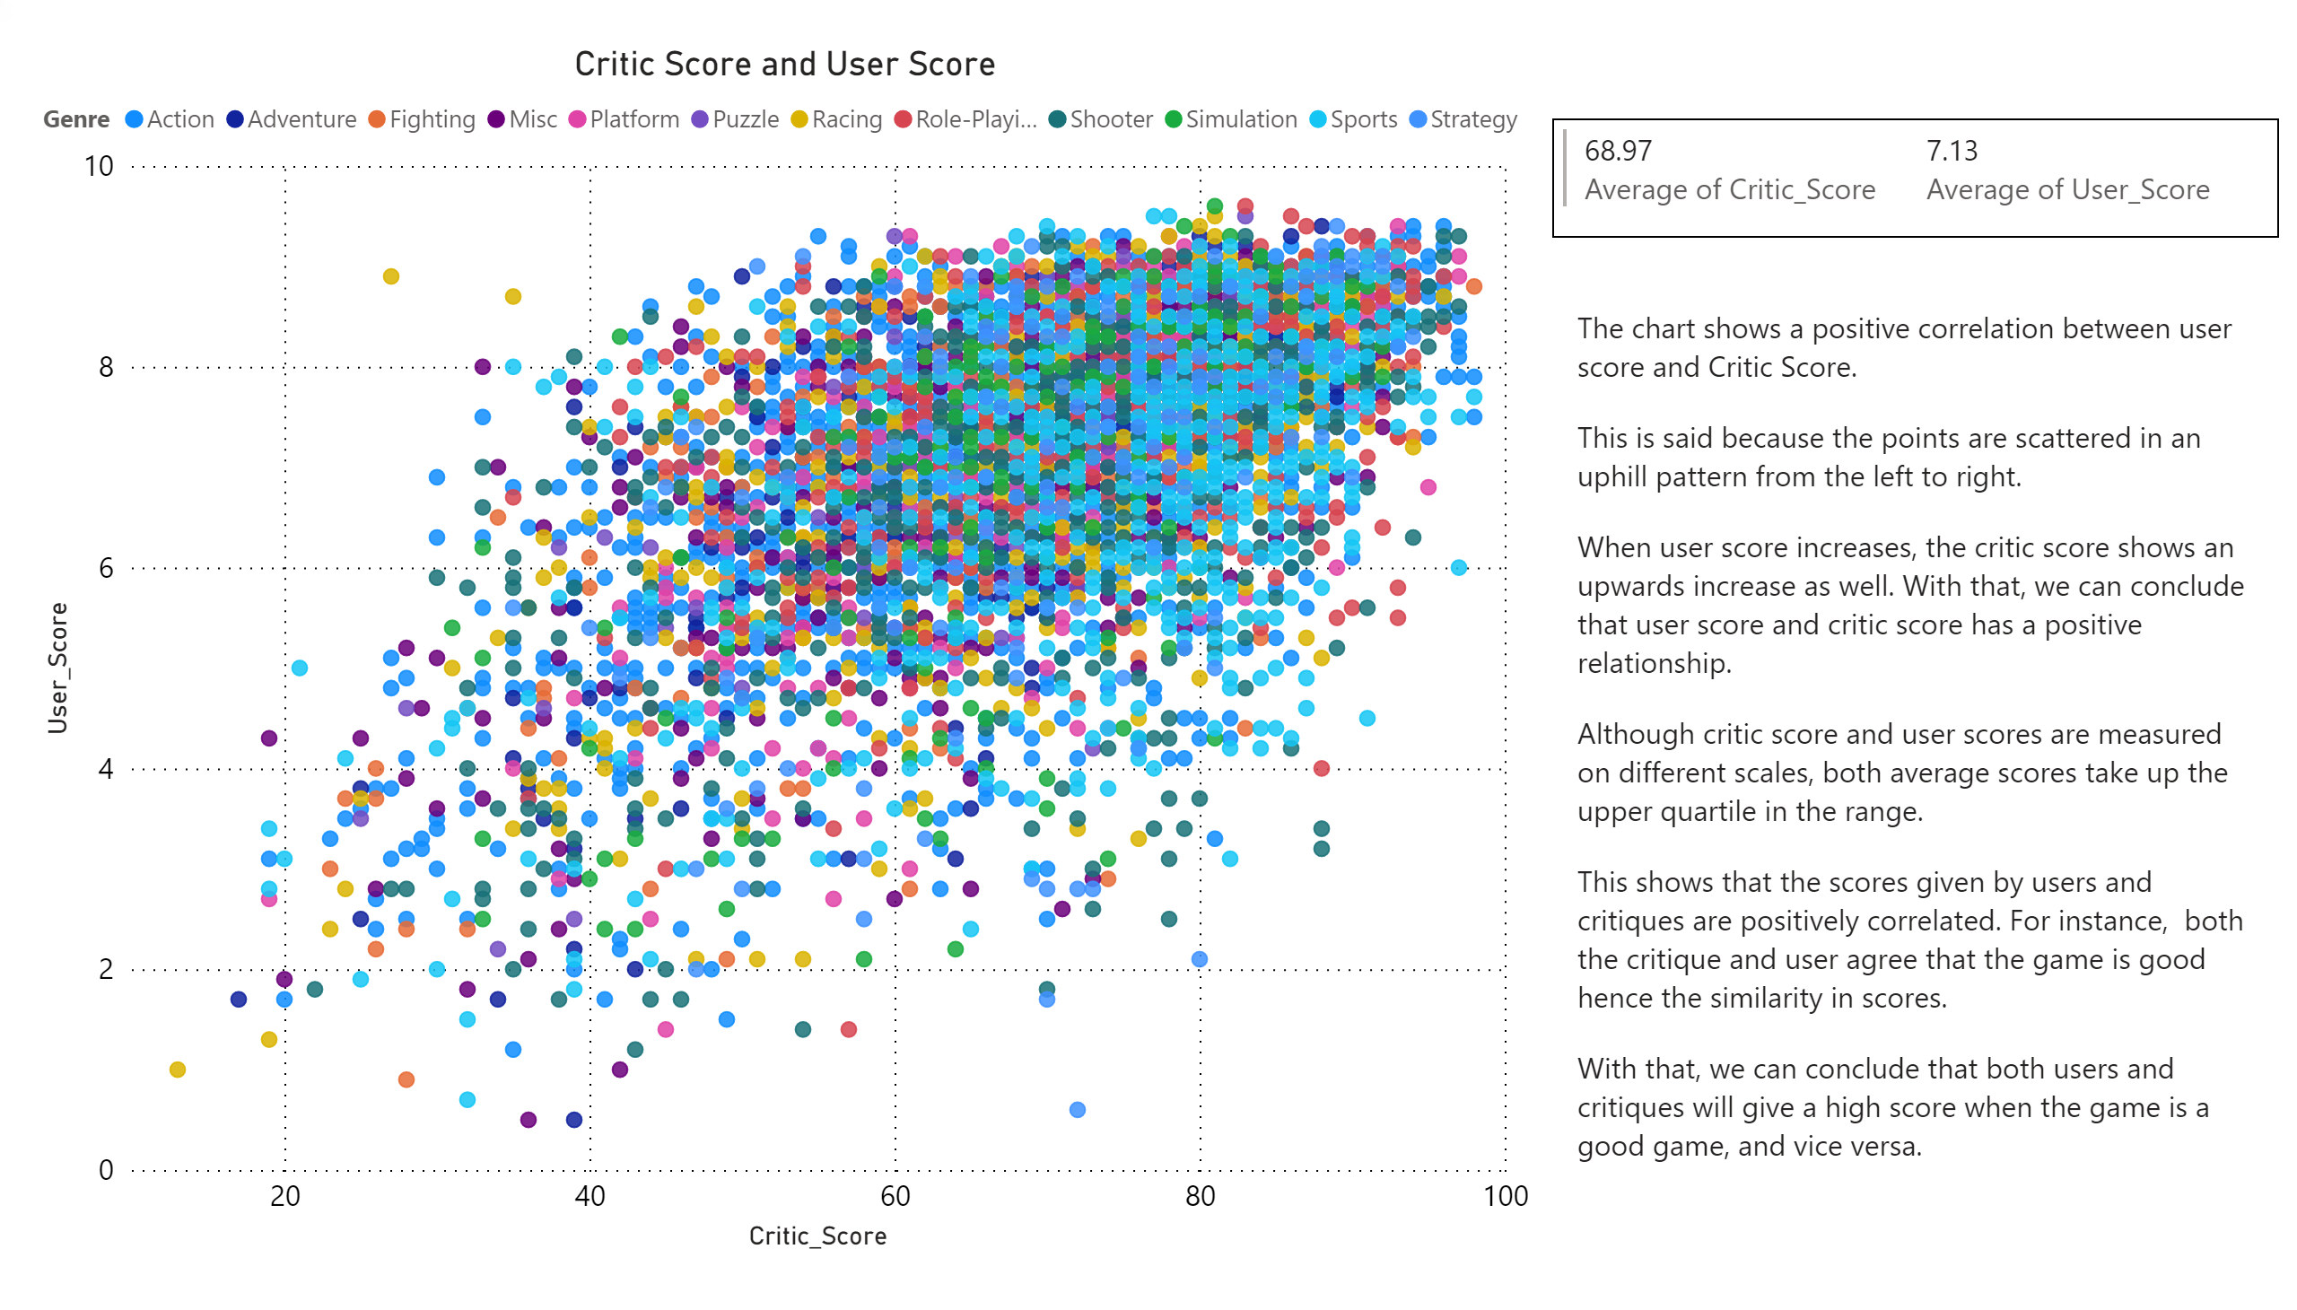
Critic Score and User Score
Notes:
multiRowCard
No alt text provided.
textbox
No alt text provided.
Critic Score and User Score
No alt text provided.

Slide 25
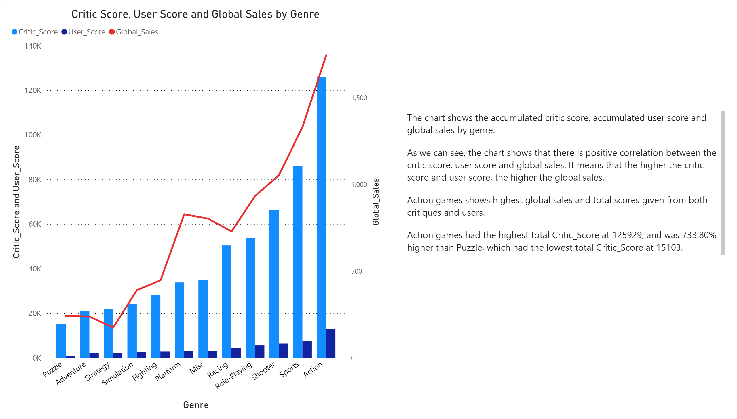
Critic score, user score and global sales by genre
Notes:
textbox
No alt text provided.
Critic Score, User Score and Global Sales by Genre
No alt text provided.

Slide 26
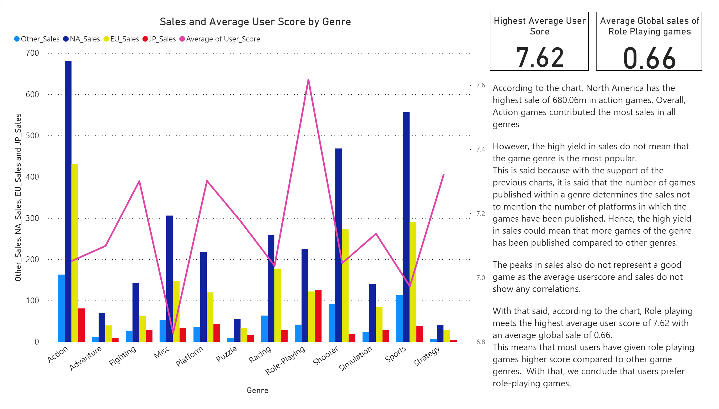
Sales and Critic Score by genre
Notes:
Sales and Average User Score by Genre
No alt text provided.
textbox
No alt text provided.
Average Global sales of Role Playing games
No alt text provided.
Highest Average User Sore
No alt text provided.

Slide 27
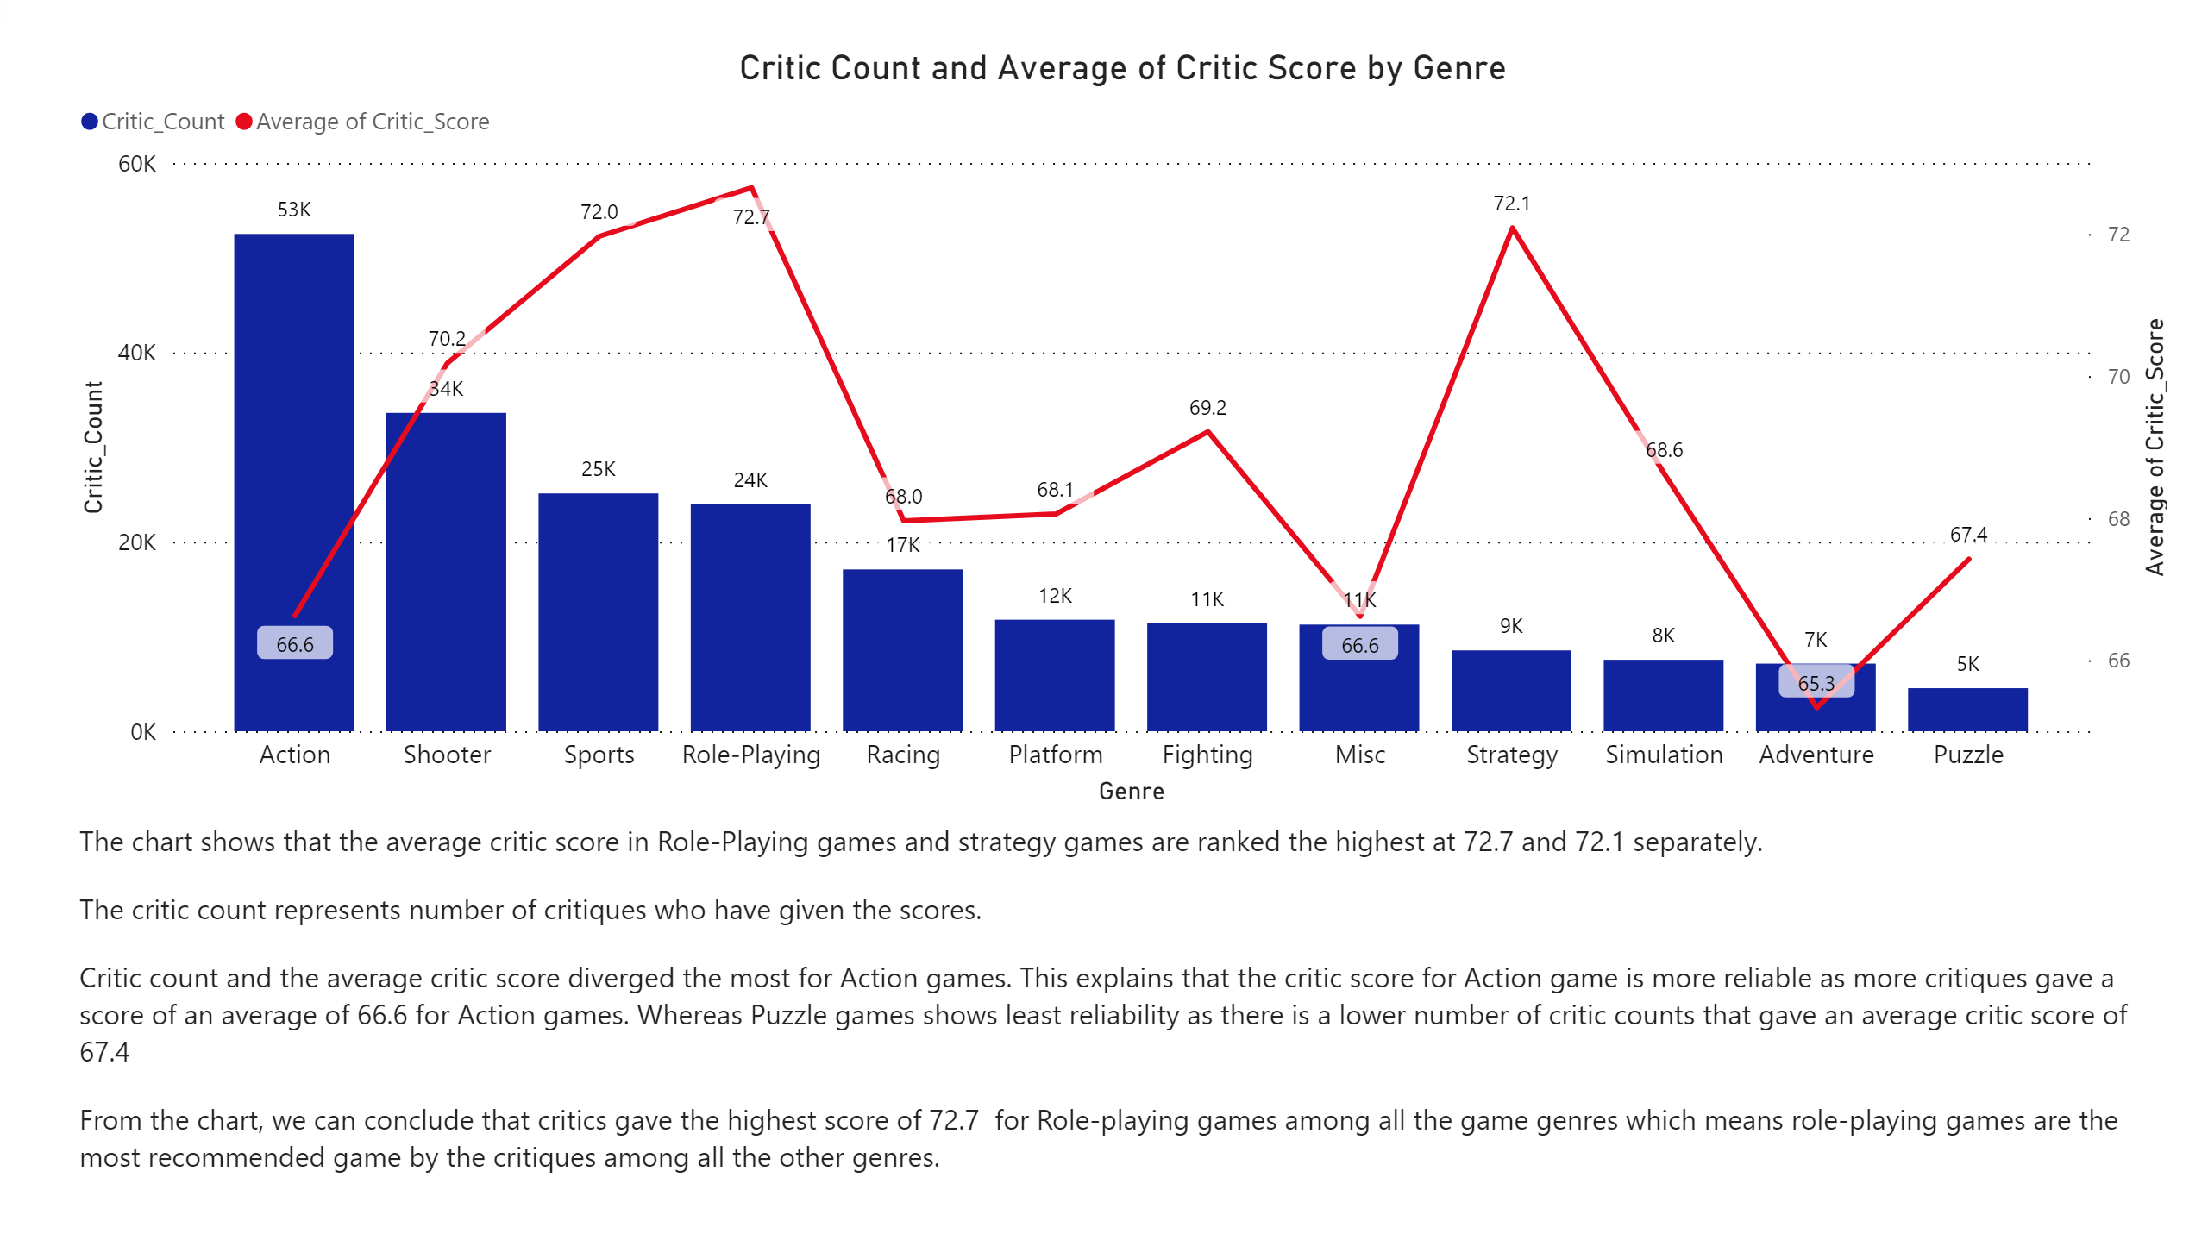
Average Critic Score by Genre
Notes:
Critic Count and Average of Critic Score by Genre
No alt text provided.
textbox
No alt text provided.

Slide 28
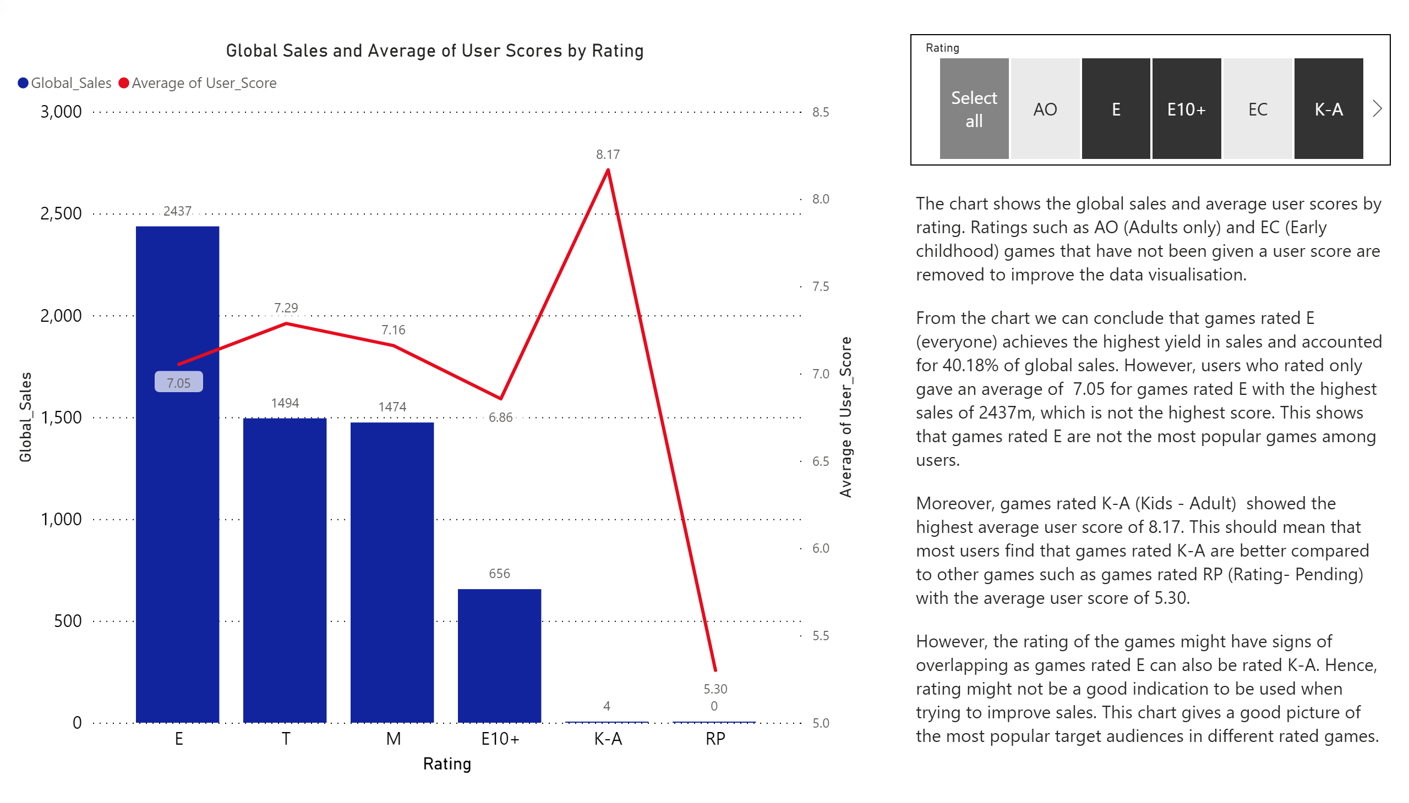
Global Sales and Average of User Scores by Rating
Notes:
Global Sales and Average of User Scores by Rating
No alt text provided.
textbox
No alt text provided.
slicer
No alt text provided.

